Slide 1
Security Provisioning: Roles & Responsibilities and Access

Slide 2
Agenda & Objective
Agenda
Manager Self Service Approvals Review
Roles Review
Transactional Roles
Query Access
Available Queries
Inquiry Roles
Training Expectations
Objective – Clarify OneUSG roles, what individuals with these roles can see and do, and discuss GT expectations for individuals in these roles, including training requirements.
Notes:
Level 1 and Level 2 Approvals Business Problem
By using two levels of approval at the departmental level, small departments will be unable to place employees at the first and second level of approval
Because all financial transactions are approved by the departmental finance representatives, these individuals must already dedicate time to approving transactions in Workday
Recommendation
Georgia Tech will modify their Approval Workflow Engine approach and require one level of approval at the departmental level in OneUSG connect
When needed, those employees initiating HCM transactions will ad-hoc Finance Representatives into the workflow
Senior Leadership will develop guidelines surrounding HCM Transactions that need financial approval

Slide 3
Available Roles
Manager
Provisioned Initiator
Express Direct Retro (EDR)
Summer Pay
Approvers (Level 1 and Level 2)
Time and Absence Approver
Time and Absence Editor
Reporting Workcenter
Job and Position Inquiry
Show Personal Data
Notes:
Level 1 and Level 2 Approvals Business Problem
By using two levels of approval at the departmental level, small departments will be unable to place employees at the first and second level of approval
Because all financial transactions are approved by the departmental finance representatives, these individuals must already dedicate time to approving transactions in Workday
Recommendation
Georgia Tech will modify their Approval Workflow Engine approach and require one level of approval at the departmental level in OneUSG connect
When needed, those employees initiating HCM transactions will ad-hoc Finance Representatives into the workflow
Senior Leadership will develop guidelines surrounding HCM Transactions that need financial approval

Slide 4
2/24/2020.

Slide 5
Manager Self Service Approval Workflow Review

Slide 6
MSS Approvals Overview
MSS and Careers transactions are subject to approval in OneUSG Connect
"Reports To"
Manager or Provisioned
Initiator Role
Department
Approvers
Level 1 (HR)
Department
Approvers
Level 2 (FIN)
Central
Approvers
(Level 4)
Central
Approvers
(Level 5)

Slide 7
Adding Approvers and Reviewers
There is functionality to add Ad-Hoc approvers and reviewers during the approval process
Approvers are required to take action
Reviewers are not required to take action
Department
Approvers
Level 1 (HR)
Department
Approvers
Level 2 (FIN)
Central
Approver
(Level 4)
Central
Approver
(Level 5)
Initiator
Ad-Hoc Approver and/or Ad-Hoc Reviewer can be added wherever there is a plus sign

Slide 8
Transactional Roles

Slide 9
Employee (BOR Employee Careers)
Who gets this role:
Granted dynamically to all employees with access to Employee Self-Service
What can this role see:
Gives access to Recruiting Self-Service page and tile
What can this role do:
Internally search for job openings and apply for jobs

Slide 10
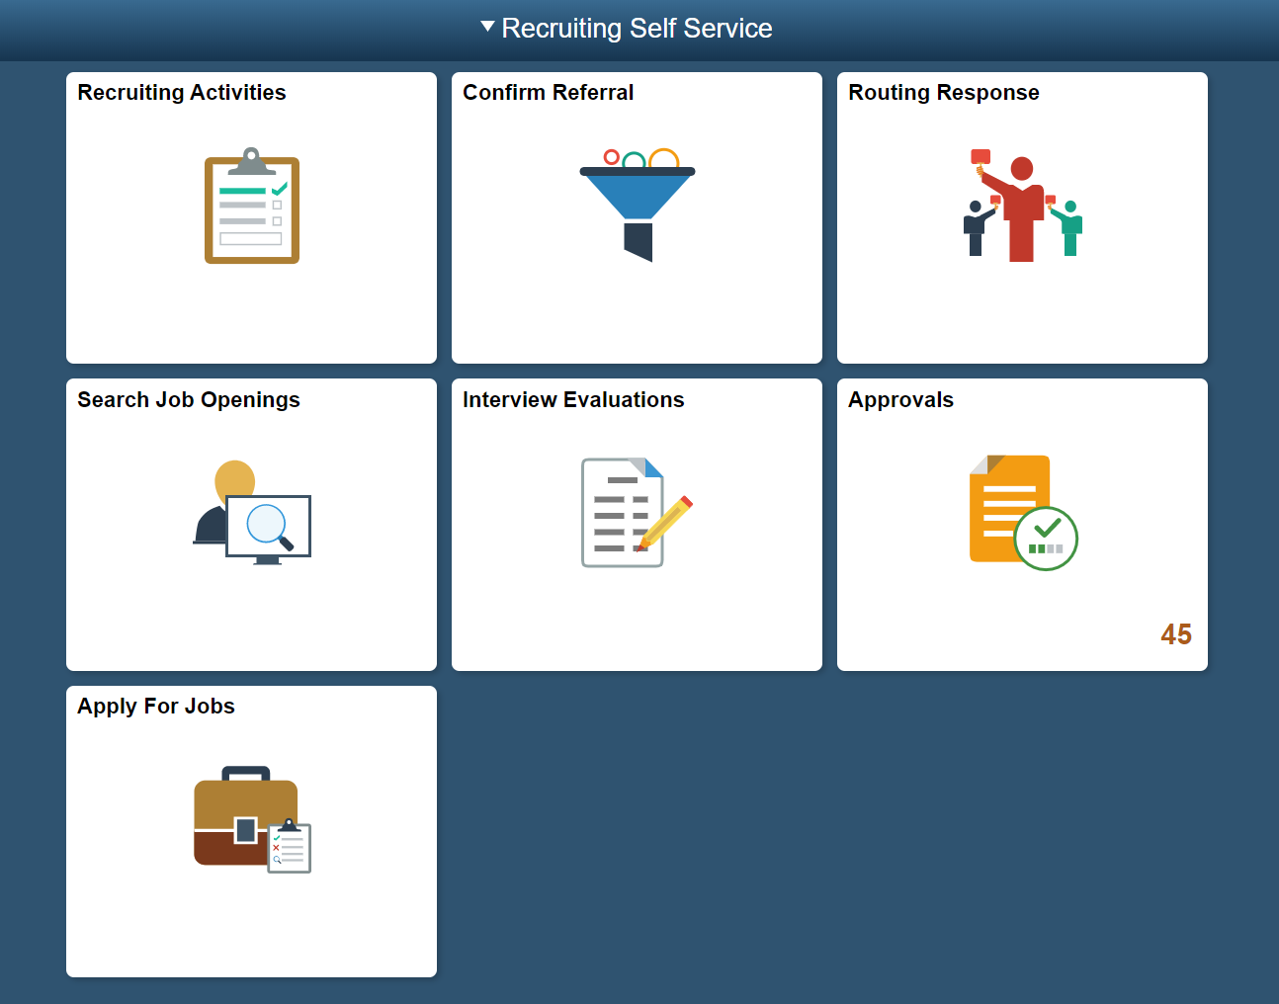
Recruiting Self Service
As an employee, a user can navigate to Recruiting Self Service to search job openings and apply for jobs.

Slide 11
Manager (BOR Manager Careers)
Who gets this role:
Granted dynamically to all employees with access to Employee Self-Service
What can this role see:
Gives access to “Open Jobs” and “Create Job Opening” tiles
What can this role do:
Create job openings
Can manage applicants and interviews
Create job offers
Create notes

Slide 12
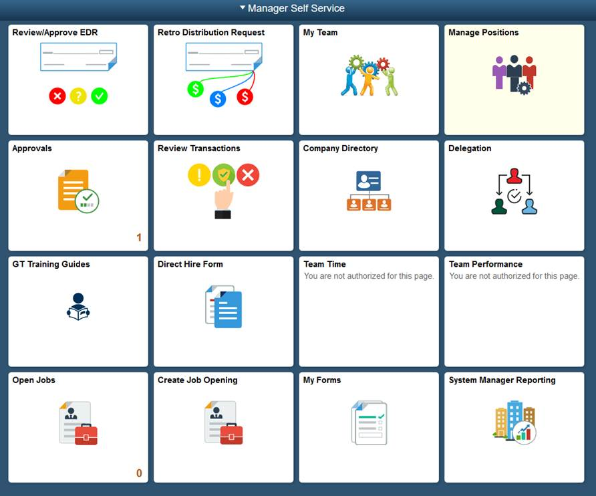
Manager Self Service
To initiate Careers transactions as a Manager or Provisioned Initiator, the user will navigate to Manage Self Service and select either Open Jobs or Create Job Opening.

Slide 13
Recruiter Admin (BOR Recruiting Administrators)
Who gets this role:
Granted to central users in Talent Acquisition
What can this role see:
Gives access to all institutional job openings
What can this role do:
Create job openings
Modify job openings
Manage applicants
Distribute job offers
Prepare applicants for hire
Request new screenings questions
Move applicants to any disposition

Slide 14
Manager (BOR GA Tech Manager)
Who gets this role:
Granted dynamically if the user has direct reports in the system
What can this role see:
A Manager can see their direct reports and those that report to their direct reports in My Team. They can also see data which is specific to those employees:
Data includes compensation and leave balances
Data includes personal information as well, not inclusive of PII data (such as Social Security numbers). There is a separate role for access to PII data.
The Manager can also see all positions that report to them, whether filled or vacant
This role by itself does NOT grant any decentralized HR inquiry page access (job, position, etc.)

Slide 15
Manager (BOR GA Tech Manager)
What can this role do:
Without any changes to row level security, this role allows the Manager to:
Approve time and absences for their own direct reports and
Manage Time and Absence Approvers and
Initiate non-EDR (express direct retro) and non-Summer Pay workflow transactions on ONLY employees in their team (see following My Team slides for additional information)
This role also allows a Manager to be added as an ad hoc into a transaction (as either an ad hoc approver or ad hoc reviewer)
Expectation: If you are a Manager (someone with direct reports) it is expected that you perform transactions, and approve time, for your direct reports unless it is inappropriate (e.g., you do not actually see your direct reports such that you could verify their time, you have a large number of direct reports, you have a chief of staff who does this for you) for you to do so.

Slide 16
Manager Self Service Transactions
These are the transactions that can be initiated by a Manager:
Position Management | HR | Time and Absence | Compensation
Add new position | Termination | Change time approver | Ad hoc salary change request
Change existing position | Promotion | Adjust leave balances | Supplemental pay request
 | Retirement
 | Transfer
 | Reporting Change
 | Demotion
 | Security Request
 | Location Change
All manager self service transactions allow attachments to be included.
Users will have the ability to select the security request transaction but will be trained to submit security requests via GT’s service request system (www.services.gatech.edu/hcm).
Careers | Commitment Accounting | Add Job Code | Miscellaneous
Create job opening | Add/Change position funding | Request new GT job code | Short term work break

Slide 17
Manager Self Service Transactions
Please note:
The following transactions cannot be initiated by a manager, only by a provisioned initiator, because the access requires row level security
Add position
Change position
Add position funding
Change position funding
Direct hire
Leadership has decided that managers will need to work with provisioned initiators for these transactions due to limitations related to row level security

Slide 18
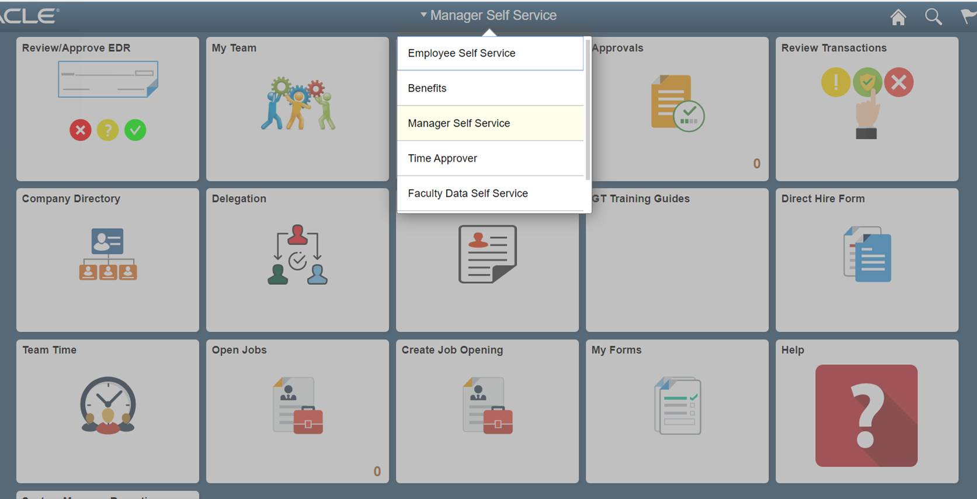
Manager Self Service Navigation
Managers will navigate using the Home Page and then selecting Manager Self Service from the drop-down.

Slide 19
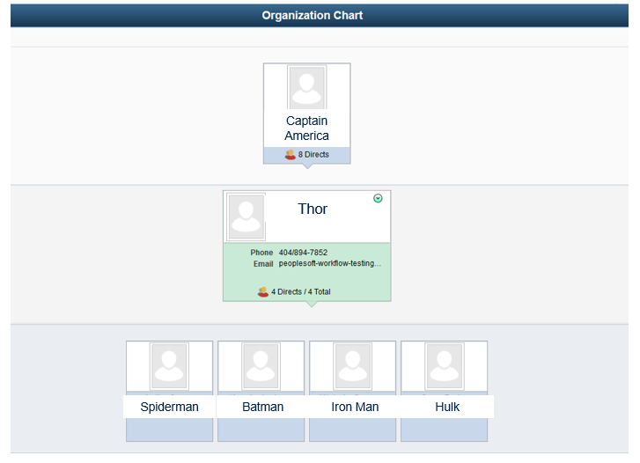
My Team View
Managers can select the My Team tile on the Home Page which allows them to see direct reports.
Managers can see not only their direct reports but also those that report to their direct reports.

Slide 20
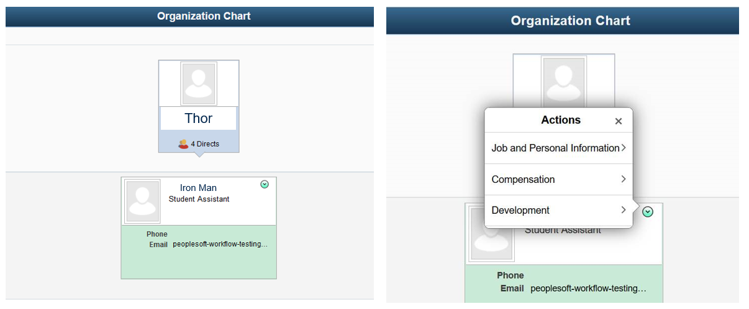
My Team View
Managers can see job and personal, compensation, and development information for direct reports and those that report to their direct reports. Managers can also initiate transactions for these employees.

Slide 21
Provisioned Initiator
Who gets this “role”:
This is not technically a role. It is a term that GaTech and OneUSG use to describe anyone who:
Is NOT a Manager but needs the ability to initiate certain transactions
Is a Manager but needs the ability to initiate transactions for more than their direct reports
What can this “role” see:
A Provisioned Initiator can see the same as the manager
Who they can see is based on row level security or assigned department(s)
The Provisioned Initiator will be able to see everyone in that department(s)
The Provisioned Initiator will be able to see compensation, time & absence info and personal information for all employees in that department(s)

Slide 22
Provisioned Initiator
What can this “role” do:
The Provisioned Initiator can initiate any type of transaction a manager can, but for more individuals because of their row level security
The Provisioned Initiator can make changes to any position within that department and initiate requests for any employee within the department(s) they have been assigned row level security
Like the Manager, the Provisioned Initiator does not receive the EDR (express direct retro) role or the Summer Pay role
Expectation: Provisioned Initiators are experts in either HR or Finance transactions, perform transactions for a Department or Departments, and are appropriate for provisioning with access to Job, Position and Personal data for many employees. All Provisioned Initiator selections will require a brief justification for HR and Finance leadership to review.

Slide 23
Manager Self Service Transactions
These are the transactions that can be initiated by a Provisioned Initiator:
Position Management | HR | Time and Absence | Compensation
Add new position | Termination | Change time approver | Ad hoc salary change request
Change existing position | Promotion | Adjust leave balances | Supplemental pay request
 | Retirement
 | Transfer
 | Reporting Change
 | Demotion
 | Security Request
 | Location Change
 | Direct Hire
All manager self service transactions allow attachments to be included.
Users will have the ability to select the security request transaction but will be trained to submit security requests via GT’s service request system (www.services.gatech.edu/hcm).
Careers | Commitment Accounting | Add Job Code | Miscellaneous
Create job opening | Add/Change position funding | Request new GT job code | Short term work break

Slide 24
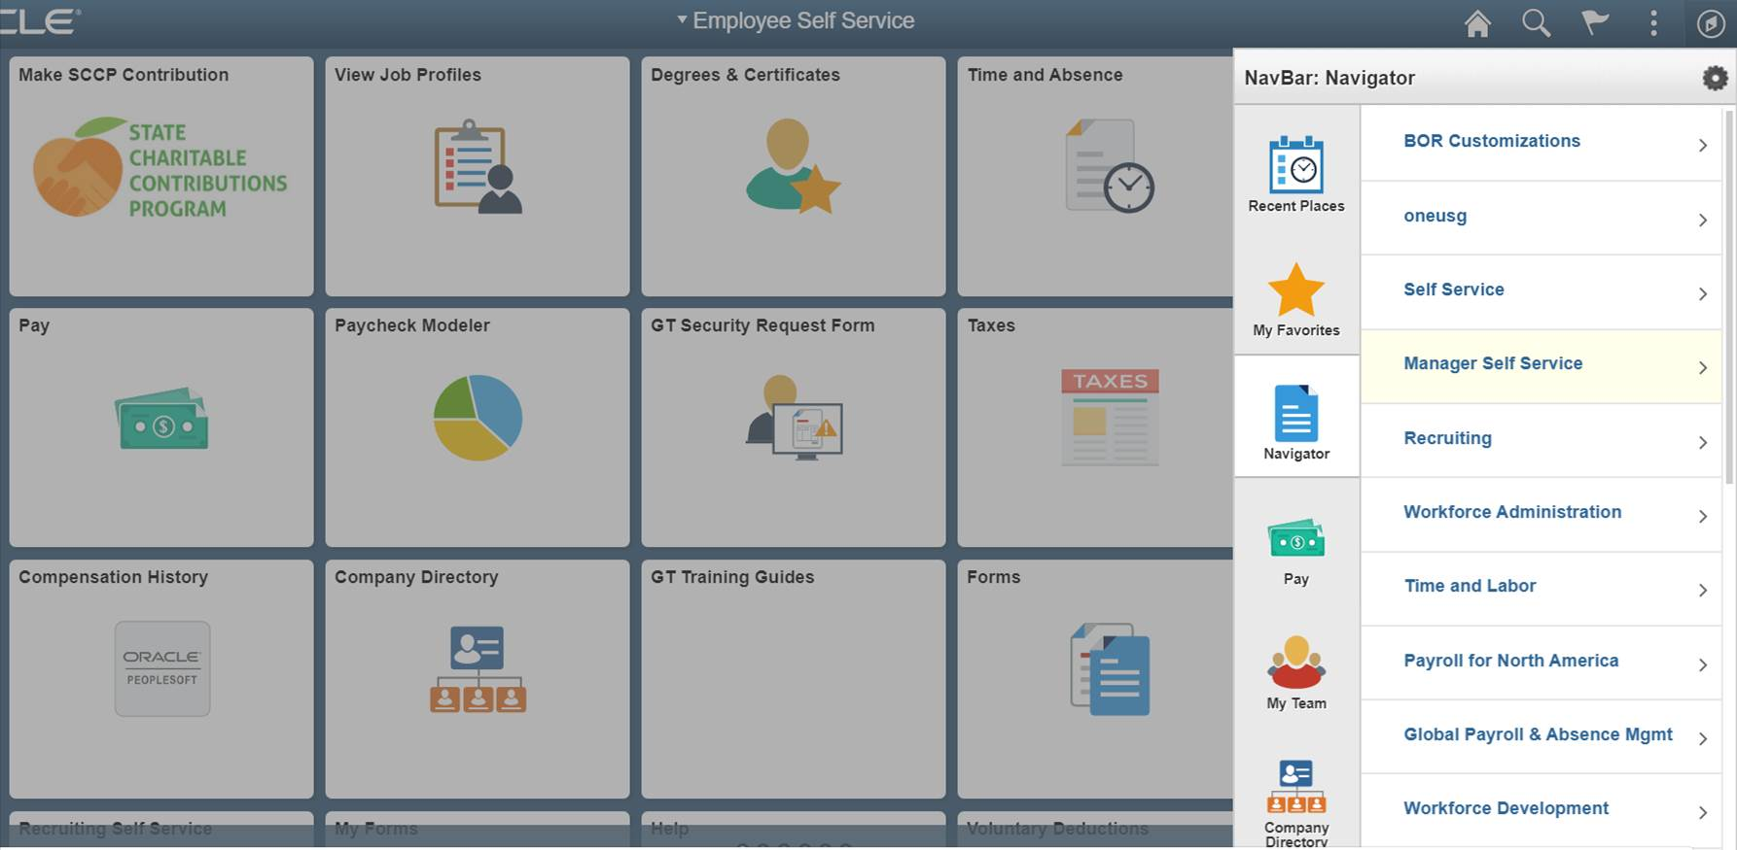
Provisioned Initiator Navigation
The Provisioned Initiator will navigate to Manager Self Service differently than the Manager. The Provisioned Initiator will select the Navigator > Manager Self Service. If the Provisioned Initiator is also a Manager, the user will be able to navigate both ways.

Slide 25
Direct Hire
Who can initiate:
Users who are provisioned initiators with row level security
Who this is used for:
Faculty positions (pilot), Students (undergraduate and graduate), Federal work study, USG Affiliate, all rehired retirees
Process:
Direct hire form will feed into Talent Acquisition for background checks
If no background check is needed, direct hire form leads to the Equifax Compliance Center/onboarding initiation
New hires will still need to go to central HR within 3 days of hire to begin the I-9 process

Slide 26
Express Direct Retro (EDR) Role
Who gets this role:
Users must be provisioned with the BOR Express Direct Retro role to initiate EDR transactions as well as the appropriate row level security
What can this role see:
Users with the BOR Express Direct Retro role will be able to view the salary distribution information for employees in the departments they have access to based on their row level security
What can this role do:
Initiate Express Direct Retro transactions
Run employee and project cost detail reports

Slide 27
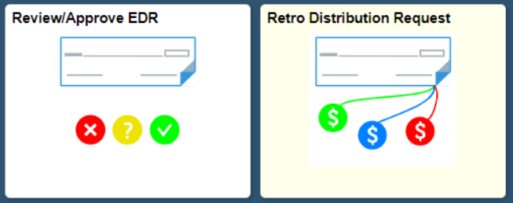
Express Direct Retro Functionality at OneUSG
OneUSG will deploy a new Express Direct Retro module for salary transfers. The module was designed to retain and enhance the existing GT SPD functionality
Managers will be able to redistribute payroll accounting transactions (salary transfers) as soon as payroll is finalized
The existing paper approval process will be replaced by a dynamic Express Retro Workflow
As soon as a payroll redistribution transaction is approved it will become available for further redistribution if required (real-time for approved transactions)
Requestors will be able to View Transactions as they move through the Workflow approval process

Slide 28
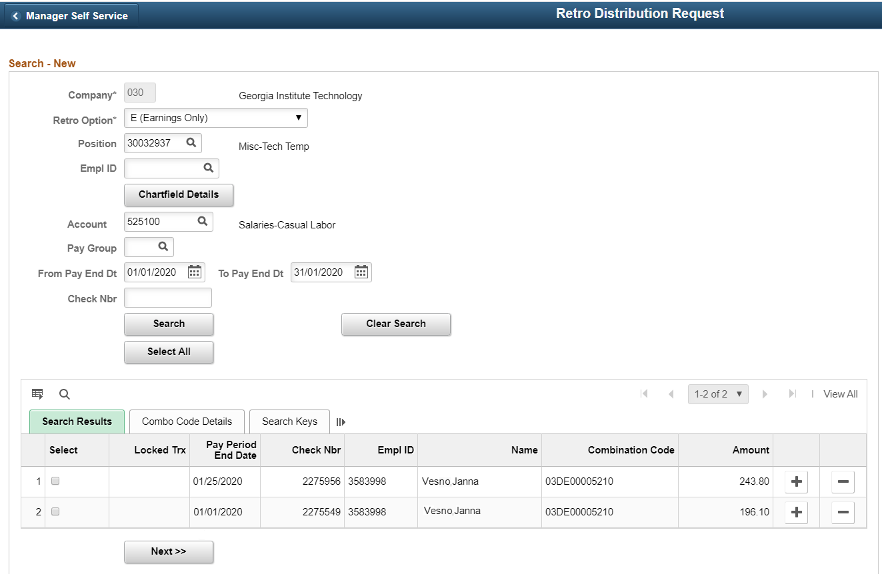
Express Direct Retro: Retro Distribution Request
Express Direct Retro Initiators will be able to search by multiple HR Attributes (Employee ID, Position Number) to locate accounting transactions
The search could be further optimized by optional criteria:
Pay End Date range
Combo Codes
Ledger accounts
Paycheck Number
Depending on their Security, Requestors will be able to select multiple transaction types to perform

Slide 29
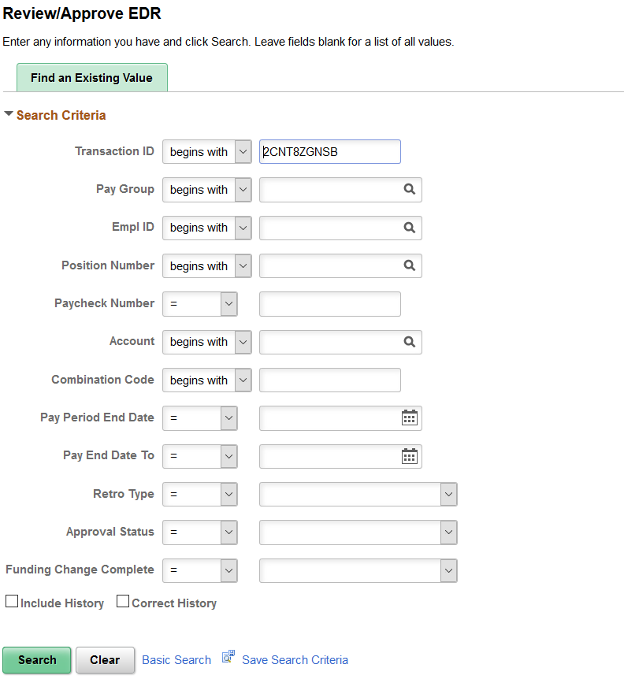
Express Direct Retro: Review/Approve EDR - Search
Express Direct Retro Approvers will be able to search by multiple HR Attributes (Employee ID, Position Number) or Transaction ID to locate accounting transactions awaiting approval
The search can be further optimized by optional criteria:
Pay End Date range
Combo Codes
Ledger accounts
Paycheck Number
Approval Status
Retro Type

Slide 30
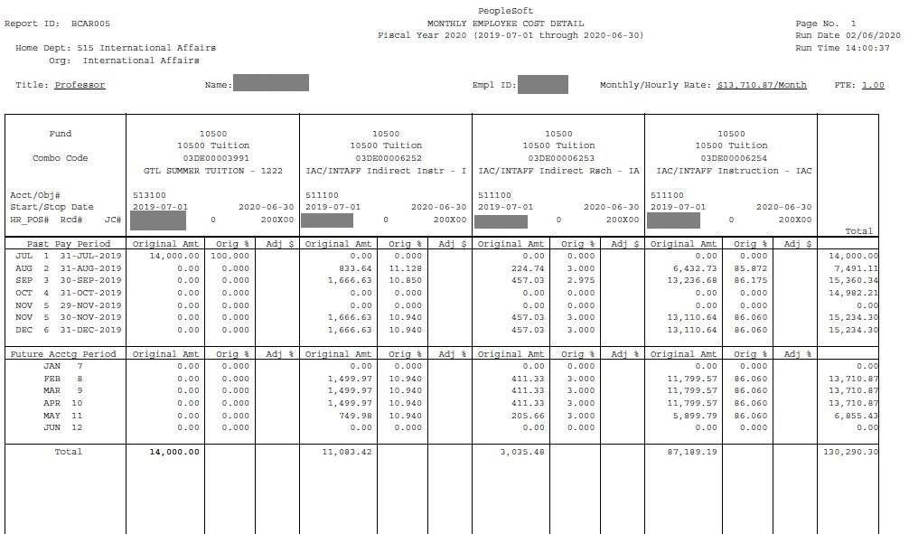
Monthly Employee Cost Detail Report
Mirrors the format and information displayed on the existing SPD Monthly Employee Cost Detail Report
Breaks down an individual employee’s cost to each affected funding source over a Fiscal Year
Displays both past and future Encumbered costs over the span of the Fiscal Year
Row level security in place

Slide 31
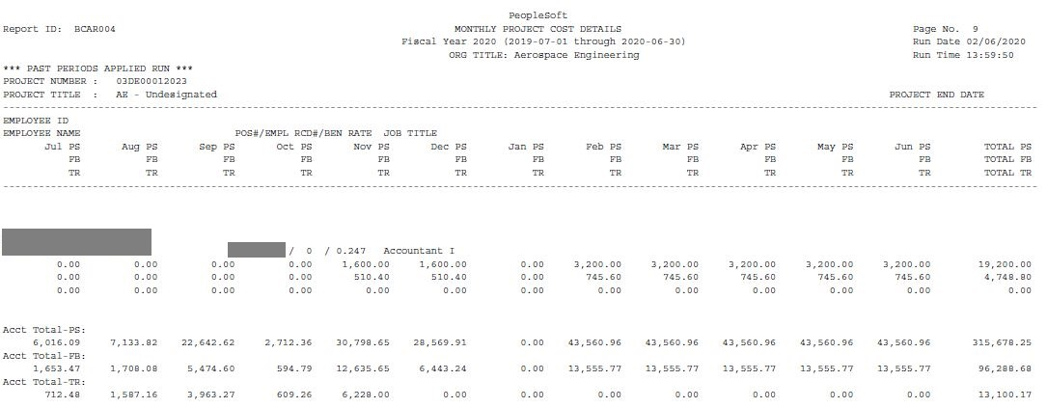
Monthly Employee Cost Detail Report
Mirrors the format and information displayed on the existing SPD Monthly Project Cost Detail GL Report
Breaks down which employees produced a cost paid for by a single project over a Fiscal Year
Breaks down the employees cost into three categories:
PS – Pay
FR – Fringe
TR – Tuition Remission
Displays both past and future Encumbered costs for the span of the Fiscal Year

Slide 32
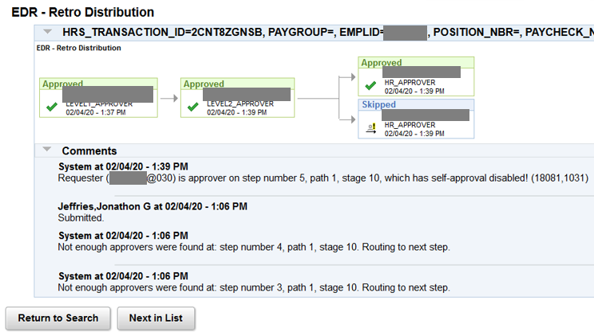
Express Direct Retro: Review/Approve EDR – AWE
Approval Workflow Engine routes EDR transactions through the following stages:
Initiator: Manager or Financial Rep that Submits EDR Transaction
Level 1 Approver: HR Rep
Level 2 Approver: Financial Rep
Level 4/5 Approver: Central CA Office
Ad hoc approvers can be added to the approval chain when situations require sign-off from additional parties
EX: AWE is based on the HR department of the employee position, so if an employee splits their time across departments, it is Business Process to ad hoc in a Financial approver from all other affected departments before it reaches the Level 4/5 Approvers or else it will be rejected

Slide 33
Express Direct Retro (EDR) Role
Expectation – The EDR Role will be provisioned to those who use SPD functionality in the current state. This provisioning has already been performed based on the existing SPD user list and in consultation with Institute Budget and Administration Office (Commitment Accounting Team).

Slide 34
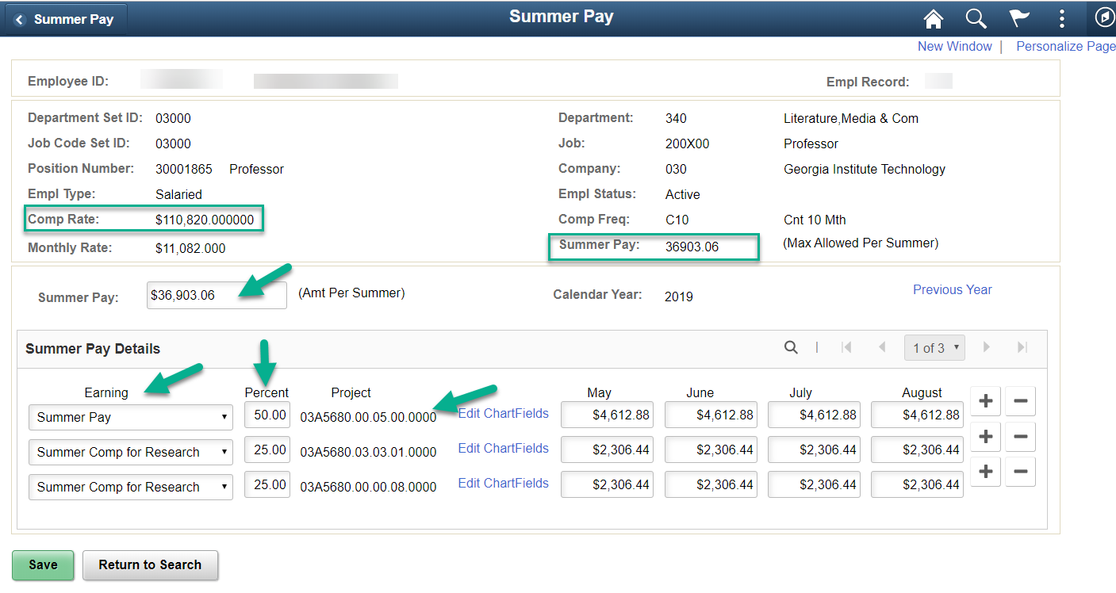
Summer Pay
There are two roles that can be given to users of summer pay
BOR Payroll Summer Pay
BOR HR Job Summary Inquiry

Slide 35
Summer Pay
Expectation – Access to the Summer Pay roles (whether inquiry or entry) will be granted to existing users of the Summer Pay functionality in GaTech’s current instance of PeopleSoft.

Slide 36
Level 1 & Level 2 Approver
Who gets this role:
This role is granted at Level 1 to the HR Approver at the decentralized level and at Level 2 to the Finance Approver at the decentralized level
What can this role see:
Approvers see pending transactions awaiting approvals
Approvers can see before and after details applicable to the transaction
For example, if there is a compensation change the Approvers will see the salary details
In general, Approvers are not able to see the same information that a Manager/Provisioned Initiator can see unless they are also either a Manager or a Provisioned Initiator
There is access to queries in PeopleSoft to support approval activities

Slide 37
Level 1 & 2 Approvers
What can this role do:
Approve transactions (any type)
Deny transactions back to the initiator if the transaction is not complete and compliant, with comments
If an Approver acts on a transaction they will be able to view their own history
However, if someone else in the approver pool approved/denied the transaction, they will not be able to see the transaction history

Slide 38
Level 1 & 2 Approvers
Note:
If a department chooses to only utilize Level 1 (HR), the expectation will be that the Level 1 Approver will ad-hoc in Finance Approvers for a specified list of MSS transactions
Approvers will be able to approve transactions that they have initiated, though they will not be able to approve transactions that they have initiated on themselves (this is what is referred to as “self-initiated”)
If an Approver approves a transaction for someone other than themselves (which they did in fact initiate), then this transaction will be denied centrally and sent back for resubmission
Approvers will need to ensure when they are monitoring their worklist so that they are not approving transactions that they have initiated to ensure that the transaction can be successfully approved centrally

Slide 39
Level 1 & 2 Approvers
Note – Email notifications are turned on globally for OneUSG. This means that approvers will receive emails corresponding to every notification, related to that employee, in the system. To manage the high number of emails, users can set a rule in their Outlook to have all OneUSG emails routed to a separate folder. In the system, users can filter the transactions waiting their approval by transaction type, date routed and requestor.
Expectation – Approver roles should be granted to those with the requisite HR and Finance policy expertise to review and audit transactions for completeness and compliance once submitted by either a Manager or an Initiator. HR and Finance Leadership will review suggested Approvers for current state compliance*.
* Individuals should not serve as both Level 1 and Level 2 Approvers without a justification. (e.g. if an employee serves in both an HR and Finance role, they can serve in both Level 1 and Level 2. However, system functionality will not allow the employee to approve at both Level 1 and Level 2 on the same transaction.)

Slide 40
Time and Absence Approver
Who can have this role:
The Time and Absence Approver assignment is controlled at the institution by the Time and Labor team on the Maintain Time Reporter Data page but is initiated as an MSS transaction
The security role (BOR TA Approver), creation of the Time and Labor Permission List, and assignment of the dynamic group will all be done dynamically by the system
What can this role do:
A Time and Absence Approver can approve and edit time and absence requests for an individual(s) who is not their direct report
If granted the Time and Absence Approver role, the user is also dynamically granted the Time and Absence Editor role (more details on next slide)
Time & Absence Approvers are setup on the individual employee level
e.g. a user can be a Time & Absence approver for a specific employee(s) not for a specific department(s)

Slide 41
Time and Absence Approver
Note:
The default in OneUSG Connect is that direct supervisors will be approving the time of their direct reports. Unlike Manager Self Service transactions, managers will only be able to see and approve time for their direct reports (they will not be able to see and approve time for their direct reports’ direct reports).

Slide 42
Time and Absence Editor
Who gets this role:
Time and Absence Editor is automatically given to Managers and Time and Absence Approvers
Time and Absence Editor may be requested by a department(s) that needs additional support managing their timesheet transactional volume
New requests should be submitted to the Payroll Time and Labor team post-go-live via a ServiceNow ticket
If the user is not dynamically either a Manager or Time and Absence Approver, then they must be assigned the BOR TA Approver role (lesser of the two roles) and given the correct row level security
What can this role do:
Time and Absence Editors have access to only edit time/absences for employees in specific departments

Slide 43
Time and Absence Editor
Example:
If a faculty member decides not to have Time & Absence Approver for their direct reports, they will be solely responsible for approving their direct reports’ time. If the faculty member is out or unavailable and has not delegated their Time and Absence authority, there will not be an employee to edit time. In current state, students go to administrative or finance employees in their department if they missed a punch and these employees edit the timesheets. This is an appropriate example where these individuals should be provisioned with the Time and Absence Editor role in OneUSG Connect.

Slide 44
Query Access

Slide 45
Queries
While Managers will have access to the Query Workcenter, without row level security this functionality will not work because the manager does not have row level security
If the Manager needs to run these reports, then they will need to be given row level security to the department
Be advised that the Manager can already see Job, Position and Personal data for everyone in their Team (Direct Reports and anyone who reports to their Direct Reports), so they may not need this additional access
But if it is granted then be aware, the Manager will have access to run the reports for the entire department
The HCM Transformation team is working with OneUSG at this time to determine if the reports available to Managers can be isolated to only their direct reports

Slide 46
Queries
If a user needs access to queries and they are not a Provisioned Initiator, they can be given the BOR Reporting Workcenter role
Access to the BOR Reporting Workcenter role gives access to ALL queries and this cannot be changed by go-live
Expectation- Query access in OneUSG will only be granted to users who need access to these available queries to perform the duties associated with their job. Please keep in mind that these queries are separate and distinct from data access provided from GaTech’s EDW.

Slide 47
Available Queries

Slide 48
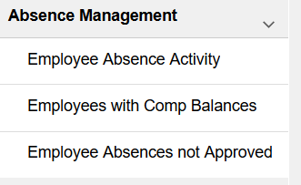
Absence Management Queries

Slide 49
WFA and MFE Queries

Slide 50
Commitment Accounting Queries

Slide 51
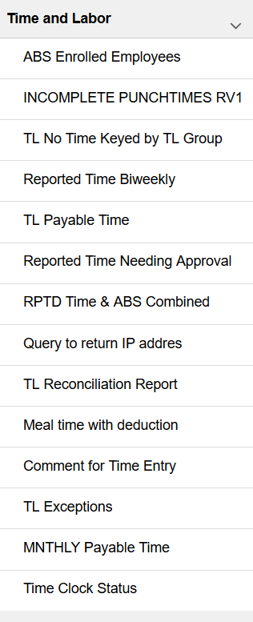
Time and Labor Queries

Slide 52
Inquiry Roles

Slide 53
Decentralized Inquiry Roles
There are two decentralized Inquiry Roles, one for Job Data and one for Position Data
Job Data Inquiry and Position Data Inquiry allow view only access to the applicable pages
Expectation - Inquiry access in OneUSG will only be granted to users who need Job and Position Data to perform the duties associated with their job. Please keep in mind that:
Managers already can see compensation and leave balances and personal information for their direct reports and those that report to their direct reports;
GTHR will review all requests for Job and Position Data access and will determine if the request is appropriate

Slide 54
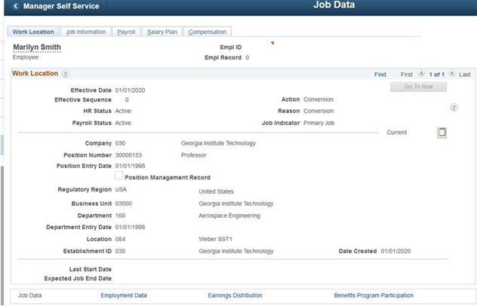
Job Data

Slide 55
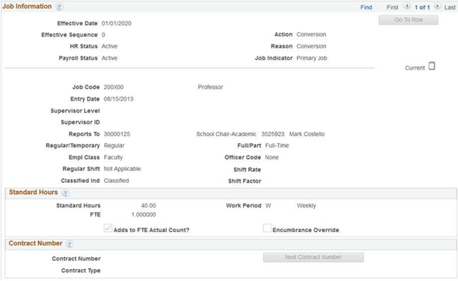
Job Data

Slide 56
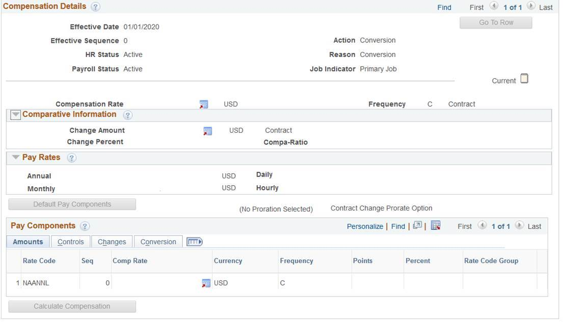
Job Data

Slide 57
Job Data

Slide 58
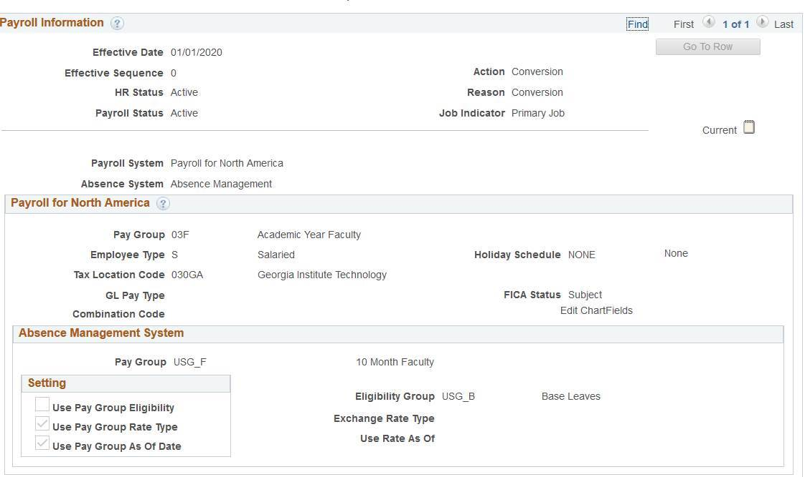
Job Data

Slide 59
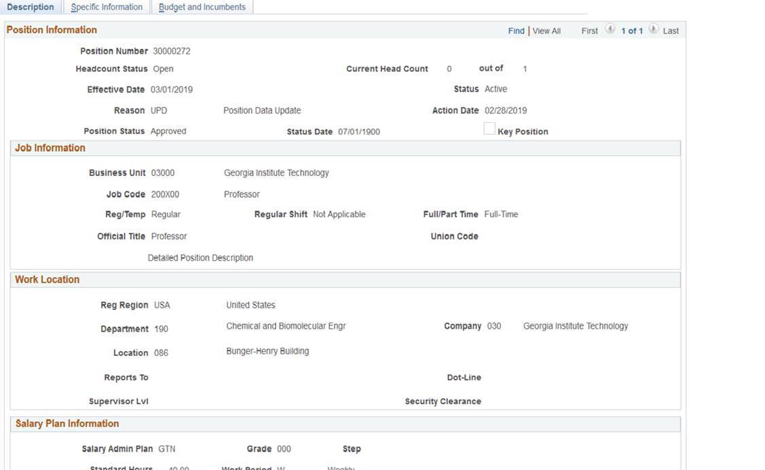
Position Data

Slide 60
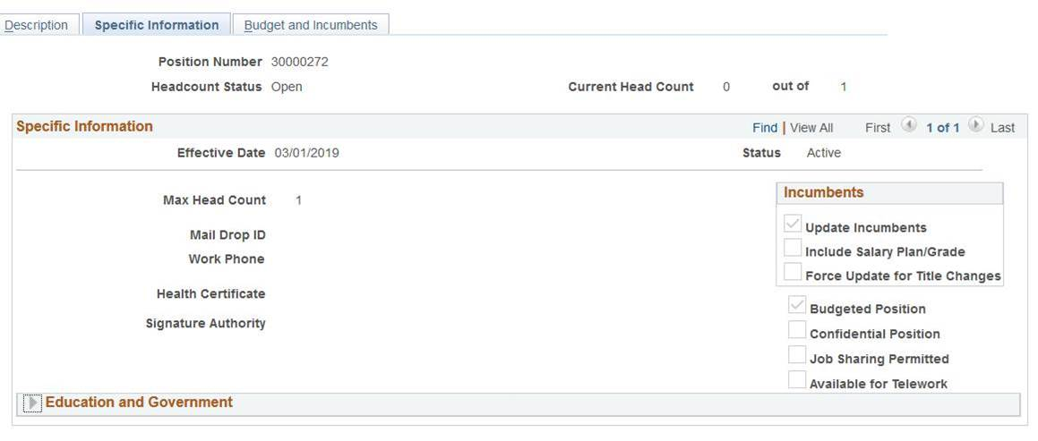
Position Data

Slide 61
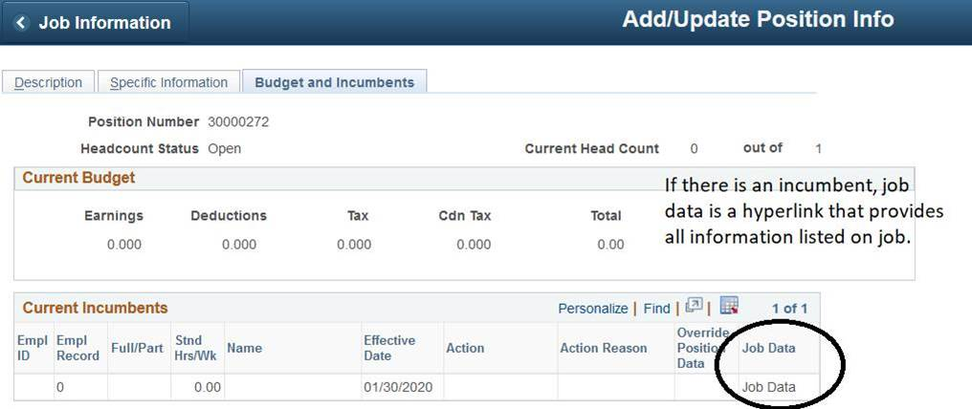
Position Data

Slide 62
Show Personal Data
What can this role see:
The Show Personal Data (PII) role grants access to view only personal data beyond home address, compensation data, etc.
Show Personal Data grants access to view elevated personal data such as Social Security Numbers
In the past, users had to have access to Social Security Numbers in order to generate a GTID
This is no longer the case, so there will be a much smaller population of users at GaTech who need access to this role
Expectation - PII access in OneUSG will only be granted to users who need access to PII to perform the duties associated with their job. Individuals have already been selected by senior leadership.

Slide 63
Training Expectations

Slide 64
Training Expectations
The following is being reviewed with the POC and Executive Steering Committee at this time:
Manager – Required to take a course introducing them to Manager Self Service functionality. Recommended to take additional courses in Manager Self Service for those transactions they perform (HR & Comp, Time & Absence Approval, and Careers (Recruiting and Hiring)). Recommended to take training on reviewing and approving time and absences if they approve time for their direct reports. Training will be provided on how to use queries.
Provisioned Initiator – Required to take all Manager Self Service courses to learn all transactions available and how to submit complete and compliant transactions. Training will be provided on how to use queries.
Express Direct Retro (EDR) – Required to take a course on Express Direct Retro functionality and associated business processes and reports.
Summer Pay –
Entry - Required to take a course on the OneUSG Summer Pay functionality
Inquiry – Training material will be provided on how to review Summer Pay inquiry pages

Slide 65
Training Expectations
Approvers (Level 1 and Level 2) – Required to take all Manager Self Service courses to learn what constitutes complete and compliant transactions for both HR and FIN levels of approval. Also required to take the Express Direct Retro course to understand approval considerations of these courses.
Time and Absence Approver – Required to take a course on reviewing and approving time and absences.
Time and Absence Editor – Will be provided training materials (job aids) on editing time.
Query Workcenter – Training materials will be provided on how to use queries.
Job and Position Inquiry – Training materials will be provided on how to use inquiry roles
Show Personal Data – Training materials will be provided on how to use inquiry roles

