Slide 1
OneUSG Connect
Campus Info Session
Careers

Slide 2
About Info Sessions
OneUSG Connect Program Overview
Recruiting & Hiring Lifecycle Overview
Position Management
Competitive Hires
  Demos
Direct Hires
  Demo
What’s Changing with OneUSG Connect?
Q&A
Closing
Notes:
General msg
Talk about the different groups we recruit for
Talk about roles
Big changes
Student and faculty in an (one) appl tracking sys
Faculty affairs – in the beginning rather than end
Position Management –
HR and accountability – less ability to change at the end. Make sure ‘ducks are in a row’ before you hit button: salary, title,

Slide 3
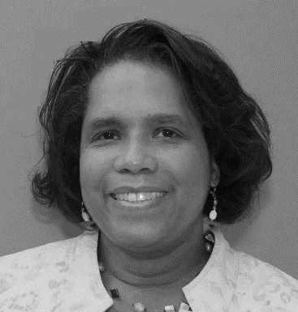
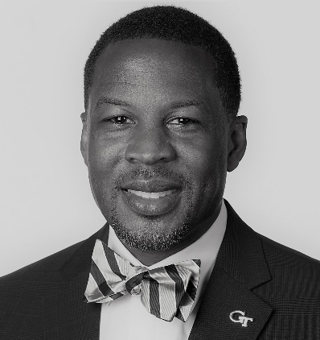
Today’s Presenters
Kara Tillman
Organizational Readiness Lead
Badra Jaden
Careers Lead
Notes:
Update as needed

Slide 4
01/15/2020.

Slide 5
ABOUT INFO SESSIONS

Slide 6
Campus Info Sessions
WHO: Open to Faculty, Staff, and Student Employees
WHAT: Campus Info Sessions are meetings highlighting a specific topic related to Georgia Tech’s transition to OneUSG Connect
WHEN: May 2019 – February 2020: Each topic will have multiple sessions hosted in various locations on campus including at least one webinar
Info Sessions HCM Transformation Overview & Employee Self-Service Manager Self-Service & Position Management Time & Labor/Absence Management & Payroll Role-based Access & Approval Workflow Student Hiring Commitment Accounting Careers
Special Topic Webinars Faculty Self-Service Workforce Administration & Global

Slide 7
Campus Info Session Expectations
These sessions are not training, training will be available Spring 2020
Today’s sessions will cover a very basic introduction to what OneUSG Connect will look like for Georgia Tech
Future sessions will demonstrate different business processes related to specific topics

Slide 8
Training
WHEN: Spring 2020
WHAT: Training will be:
A mix of instructor-led classroom training and web-based training.
Supplemented with job aids/process guides that you will be able to access at any time to help walk you through processes in OneUSG Connect.
WHERE: The launch point for any training will start at the Transformation website. There you will be able to sign up for trainings, attend virtual courses, and download helpful resources.
10%
Structured Learning
Web-Based Training, Instructor-Led Training, Seminars
Social Learning
Open Lab Sessions, Change Agents
20%
Experiential Learning
On-the-Job Assignments, Problem Solving, Practice, Quick Reference Guides, Job Aids, Videos, Workshops
70%

Slide 9
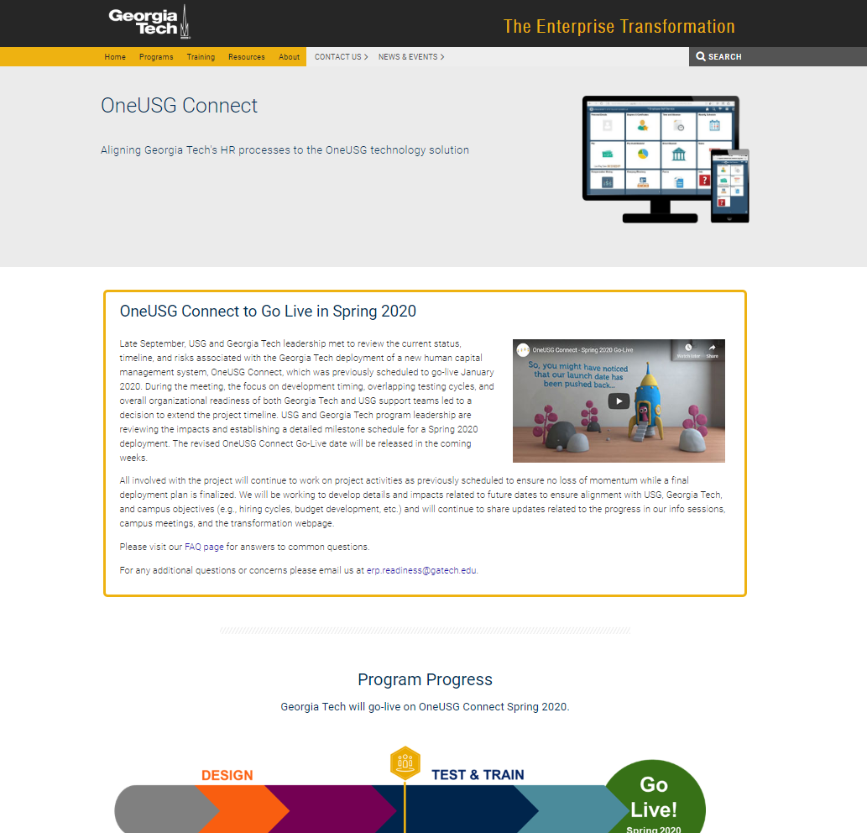
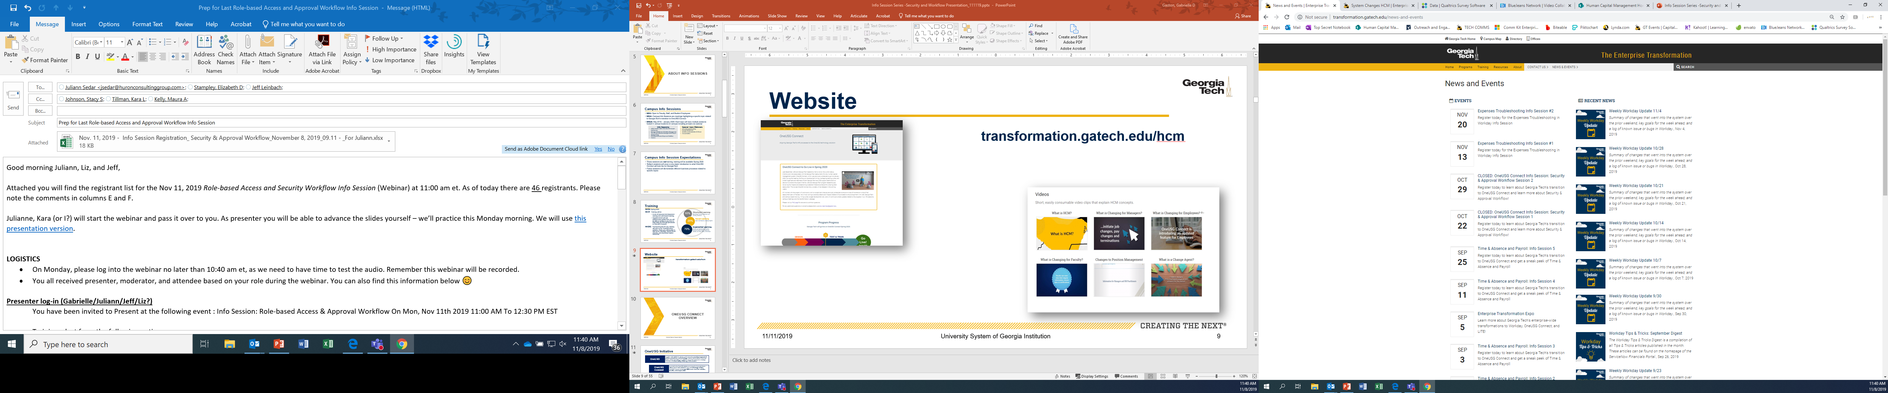
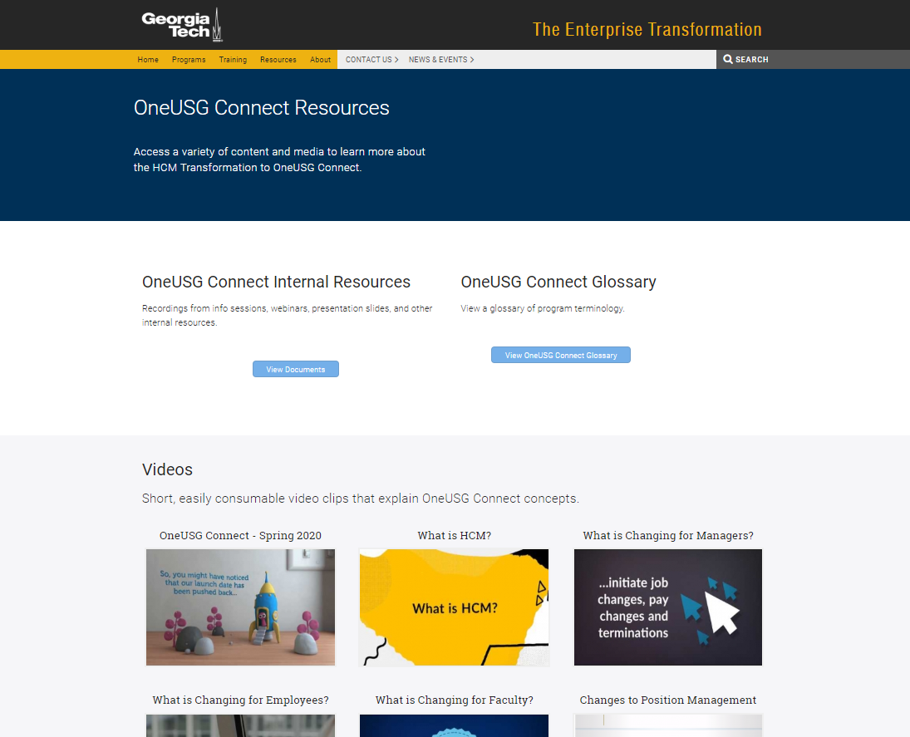
Website
transformation.gatech.edu/hcm

Slide 10
ONEUSG CONNECT OVERVIEW

Slide 11

OneUSG Vision
All USG institutions will adopt a consistent approach to policies, procedures, and technology
Notes:
To provide some context and clarify terms – OneUSG is vision of Chancellor to have a consistent approach to policies, procedures and technology across the university system to support strategic imperative of accountability, efficiency and innovation.

Slide 12
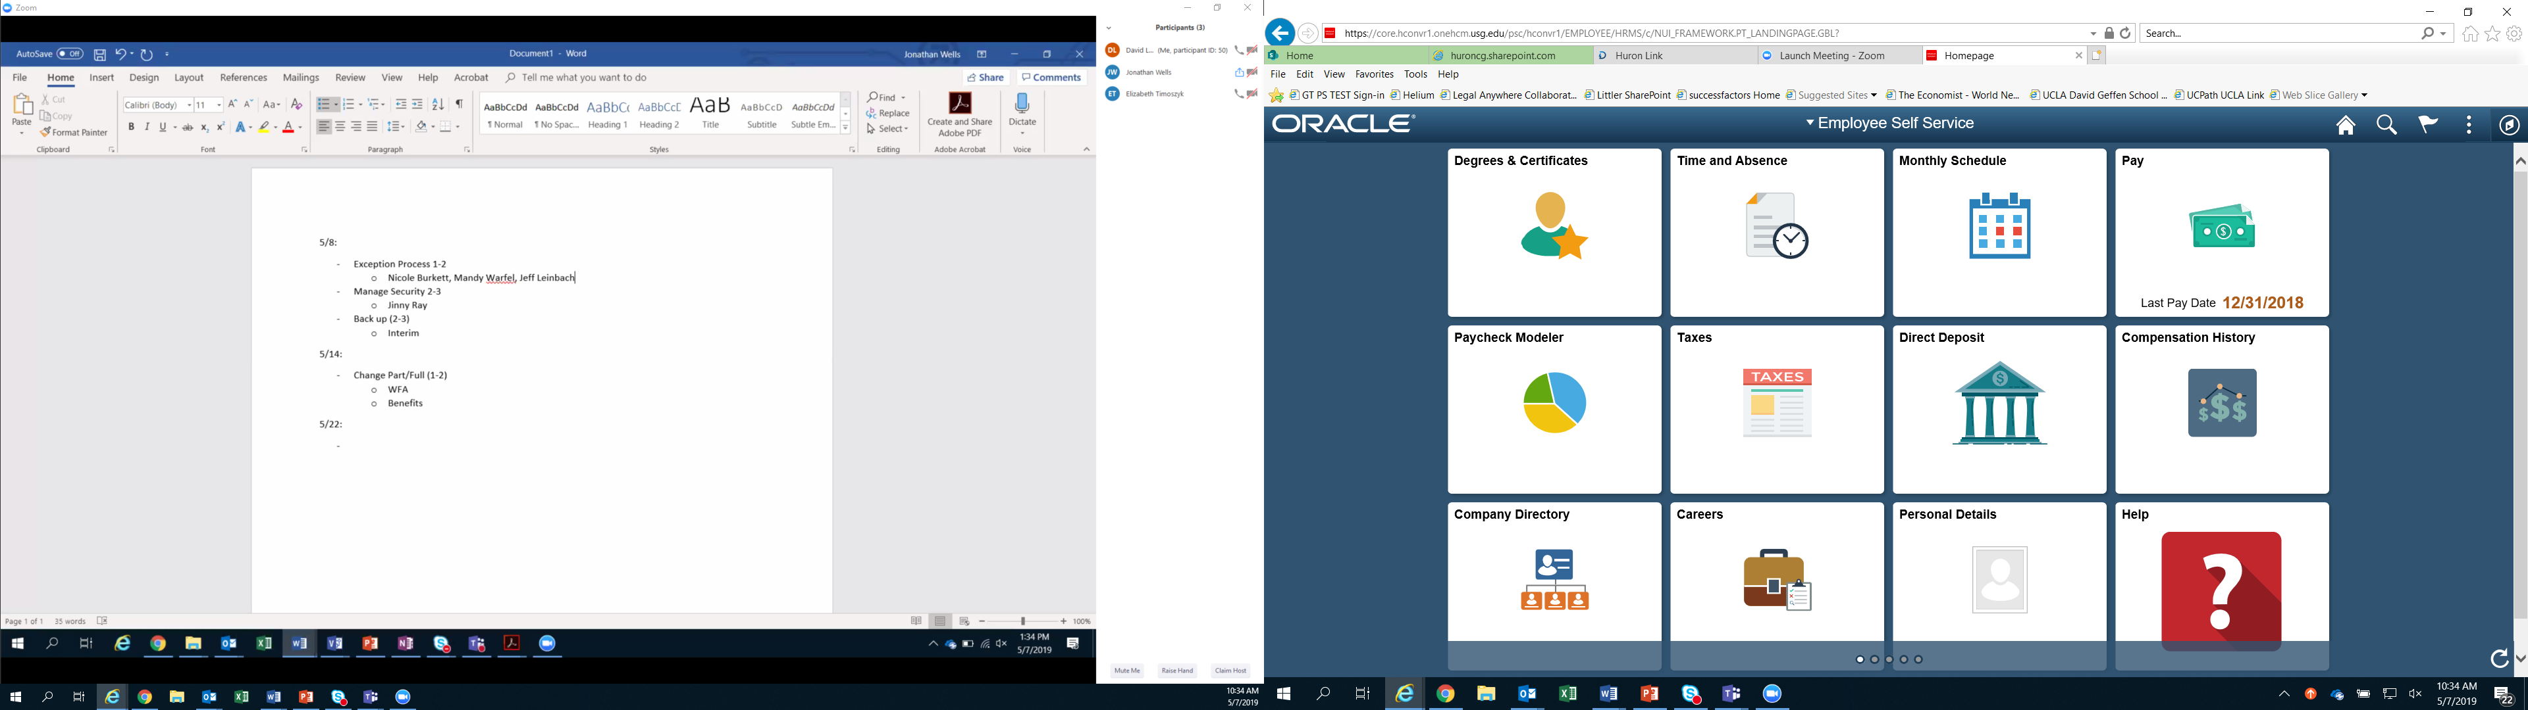
OneUSG Connect
All USG institutions will transition to a new technology platform, OneUSG Connect, to manage human resources activities, benefits, and compensation
Notes:
OneUSG Connect is the system-wide initiative to move all USG institutions to a new technology platform

Slide 13
OneUSG Connect Updated Timeline
Sept 2019 | Oct 2019 | Nov 2019 | Dec 2019 | Jan 2020 | Feb 2020 | Mar 2020 | Apr 2020 | May 2020 | Jun 2020 | Jul 2020 | Aug 2020 | Sept 2020 | Oct 2020 | Nov 2020 | Dec 2020 | Jan 2021
Campus Info Sessions
Testing
User Acceptance Test Training
UAT
Training
HR
HR Practitioner Training
Training
Campus Training
Instructor-Led Training, Web-Based Training, Job Aids, Seminars, etc.
Go Live
Open Labs
Department Wellness Checks
Careers Phase 2
Faculty (non-GTRI)
Careers Phase 3
GTRI
Competitive
Students
University System of Georgia Institution

Slide 14














Today's Topics
OneUSG CONNECT MODULES |  |  |  | ADDITIONAL CHANGES
 | Careers |  | Workforce Administration |  | System Approvals
 | Benefits |  | Payroll |  | Security Changes
 | Self-Service |  | Commitment Accounting |  | Business Process Changes
 | Global |  | Faculty Events |  | Policy Updates
 | Time & Labor / Absence Management |  | Time Clocks |  | Shared Services for Tier 1 Support
Notes:
Scope at GT (Careers, Workforce Administration, Self-Service, etc.)
Module slides
System approvals (more detail in MSS)
Security changes
Business process

Slide 15
CAREERS
(RECRUITING, ONBOARDING AND HIRING)

Slide 16
Recruitment & Hiring Lifecycle
Post Job
Interview and Select Applicant
Extend and Accept Offer
Competitive
Hiring Department GTHR Talent Acquisition
Background Check
Onboarding Packet
Create Employee and Job
(Workforce Administration) (Update HR)
Add/Change Position
Competitive Hire or
Direct Hire
Hiring Department
TA CSC HRIP
Georgia Tech Human Resources
Direct
Submit Hire
Approval Workflow
Hiring Department GTHR

Slide 17
Terminology
Current
Applicant Tracking System – Software application that enables the electronic handling of recruitment (e.g., Taleo, RecruiterBox, PageUp)
Position Management - Systems used to manage vacant and filled positions in Org/Department
Onboarding – Process of completing paper employment forms and policy acknowledgments for submission to GTHR Customer Service Center (CSC). Initiates some ID Management functions.
Future
Applicant Tracking System – Software application that enables the electronic handling of recruitment and hiring (i.e., Careers)
Position Management – Module is used to manage vacant and filled positions in Org/Department, track job details, and facilitate the maintenance of funding and budgets
Onboarding – Process of completing employment forms and policy acknowledgments online. Initiates ID Mgt prior to visiting CSC.
Careers – OneUSG Connect recruitment and onboarding module
Direct Hire – Functionality in MSS to hire candidates who have already been identified for a role/position
Job Profile – Job description database

Slide 18
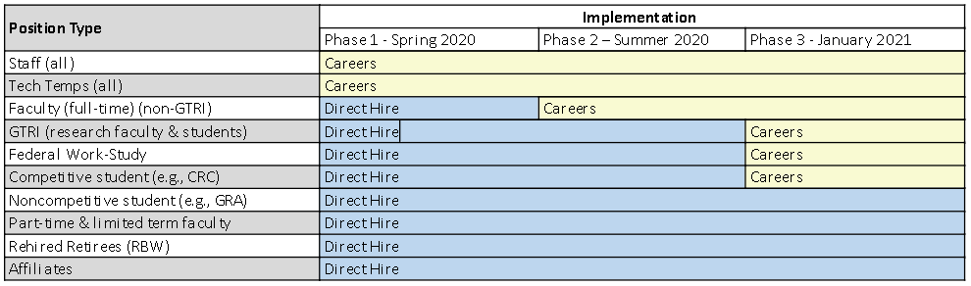
Phased Implementations

Slide 19
Careers Phased Implementation
Phase I – Spring 2020
Phase II – Summer 2020
Phase III – January 2021
Staff, Tech Temps, Faculty pilot units (President/Provost/EVPR & College of Computing)
Academic Faculty, Research Faculty (non-GTRI)
Students, GTRI (Research Faculty), Federal Work Study Students

Slide 20
Position Management
Post Job
Interview and Select Applicant
Extend and Accept Offer
Competitive
Background Check
Onboarding Packet
Create Employee and Job
(Workforce Administration) (Update HR)
Add/Change Position
Competitive Hire or
Direct Hire
Hiring Department
Georgia Tech Human Resources
Direct
Complete Form
Approval Workflow

Slide 21
Foundational Concept
Positions are the foundation of OneUSG Connect, the common thread that binds job, funding and organizational data together. Position Management is used to manage vacant and filled positions in Org/Department, track job details, and facilitate the maintenance of funding and budgets.
Job
Payroll
Position
Funding
Budget

Slide 22
Why Use Position Management?
Position Management is used for organizational planning, recruitment, career planning and budgeting.
Positions:
  Link key data elements and facilitate the hiring process
  Help to define the hierarchy and organizational structure of a department
  Tie employees to accounting chart fields that determines how labor costs are distributed

Slide 23
Position Management Changes
Position Management will be centralized, with GTHR supporting management of the process.
Managers and/or Initiators will play a vital role initiating the Position Management process.
Every employee in a Group Position will be moved to their own "Single Position“.
Funding distribution will be associated with the position rather than the employee.

Slide 24
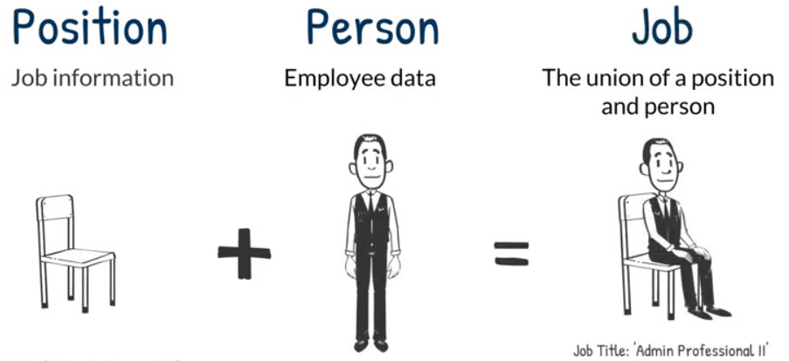
What is Position Management?
Position Management is composed of three components: Position Data, Personal Data, and Job Data.
Job Title: Admin Professional, II
Job Code: 515X01
Work Location: East Campus Building
Reports-To: Jane Smith
Department Name: Administration
Job Title: Admin Professional, II
Job Code: 515X01
Work Location: East Campus Building
Reports-To: Jane Smith
Department Name: Administration
Name: Chris Doe
Employee Class: Staff
Name: Chris Doe
Employee Class: Staff
Notes:
Talking Points:
Position data is systematically defaulted into other modules (e.g. Workforce Administration, Time & Labor, Payroll, Absence Management, etc.)
For example, position data:
Position Attributes will roll over to Job Data resulting in data alignment between Position Management and Job Data (Job Title, Reports To, FLSA Status, etc.)
Funding placed on position will roll over to Commitment Accounting
Position data remains the same regardless of employee in the position. The person can shift but the position stays.

Slide 25
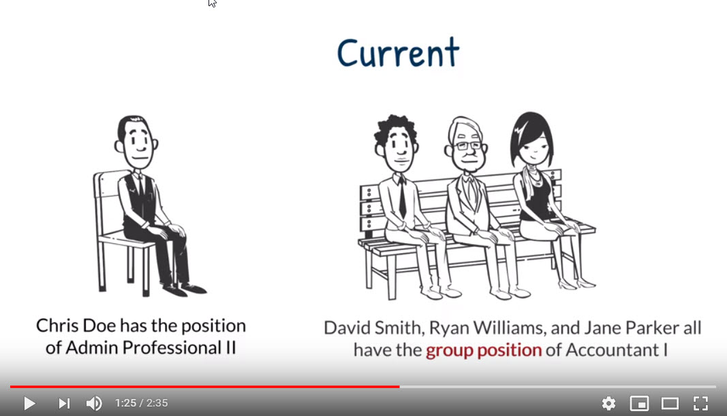
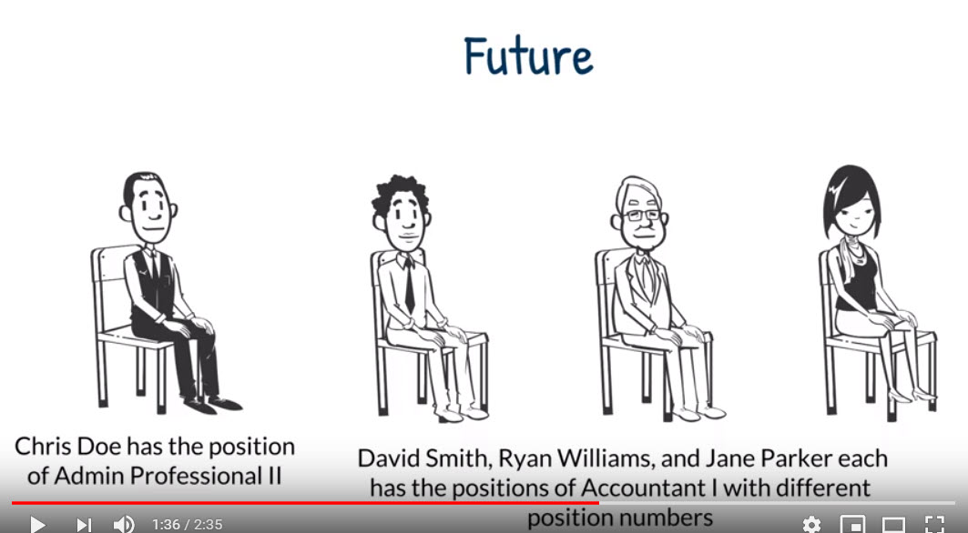
Position Attributes
Employees must share all position attributes in order to be assigned to a group position.
Group positions have multiple headcount and/or incumbents, thus position changes impact all employees in that position.
As of March 23, 2020* GT will use single headcount positions.
Same Job Code & Position Number
Same Funding
Same Reports-to
Chris Doe has the position of Admin Professional II
David Smith, Ryan Williams, and Jane Parker all have the group position of Accountant I
Chris Doe has the position of Admin Professional II
David Smith, Ryan Williams, and Jane Parker each has the position of Accountant I with different position numbers
Notes:
Current State
The custom Salary Planning Distribution (SPD) system is used to store employee’s funding detail at the job level
Georgia Tech currently allows multiple incumbents to reside in a single position, if the employees share the same position attributes such as Business Unit, Department, and Jobcode etc
Future State
The SPD system will be retired and replaced with enhanced Commitment Accounting functionality.
All employees in a group position must have the same funding sources and distribution percentages
Impacts
Funding for all employees will be stored at the position level, which will impact how group positions can be leveraged in the future state.
Due to the complex nature of funding at Georgia Tech, the use of group positions will be eliminated.

Slide 26
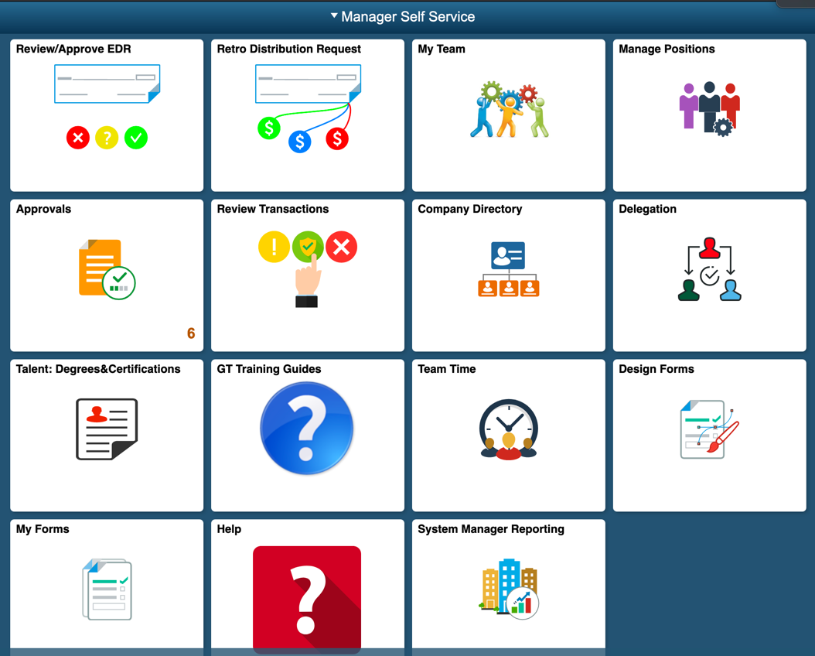
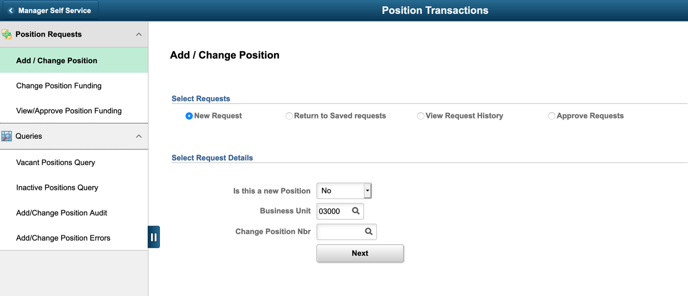
Self Service – Position Management

Slide 27
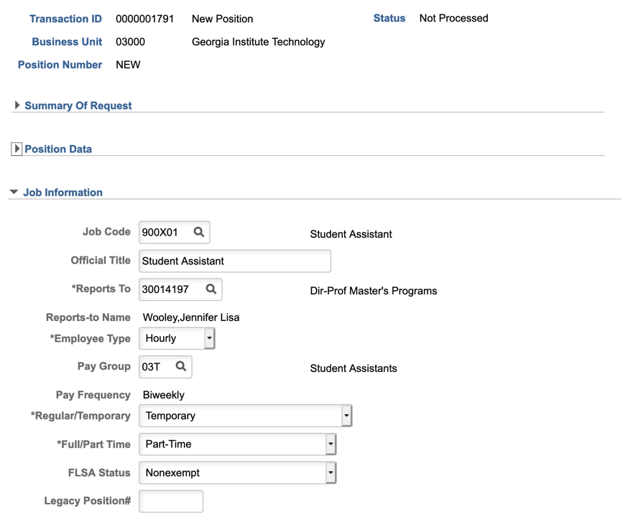
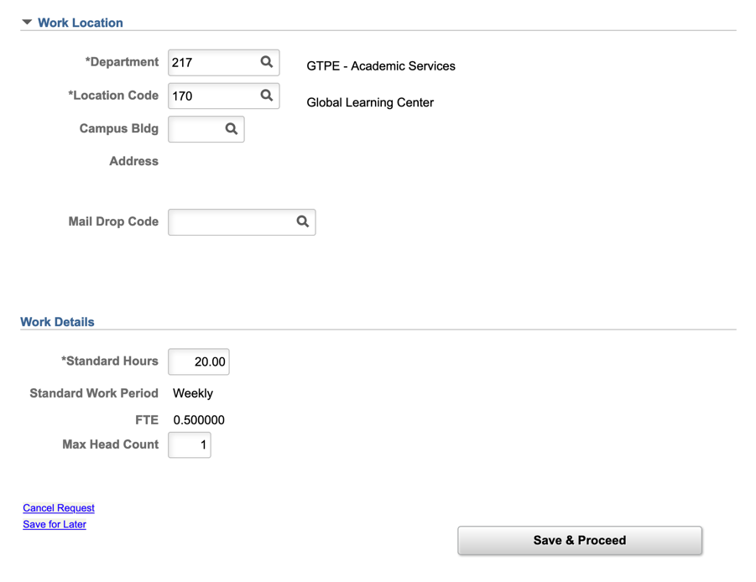
Self Service – Position Management

Slide 28
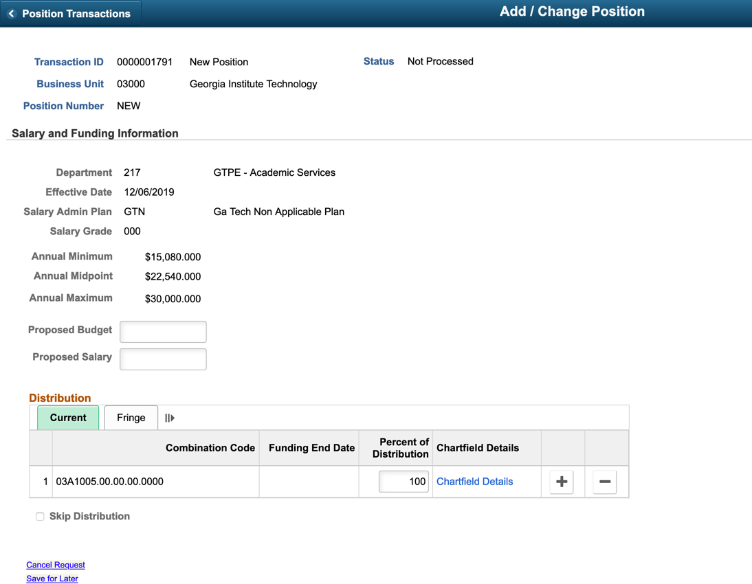
Self Service – Position Management

Slide 29
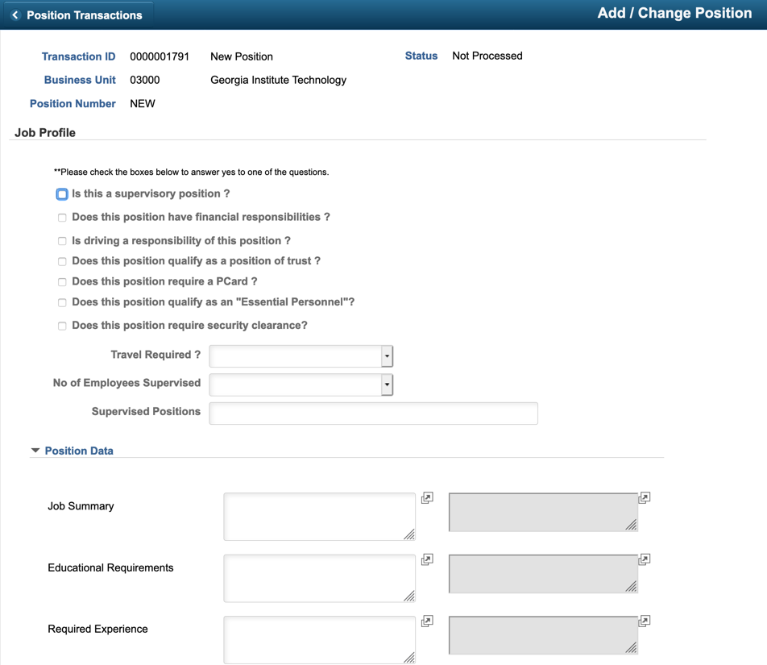
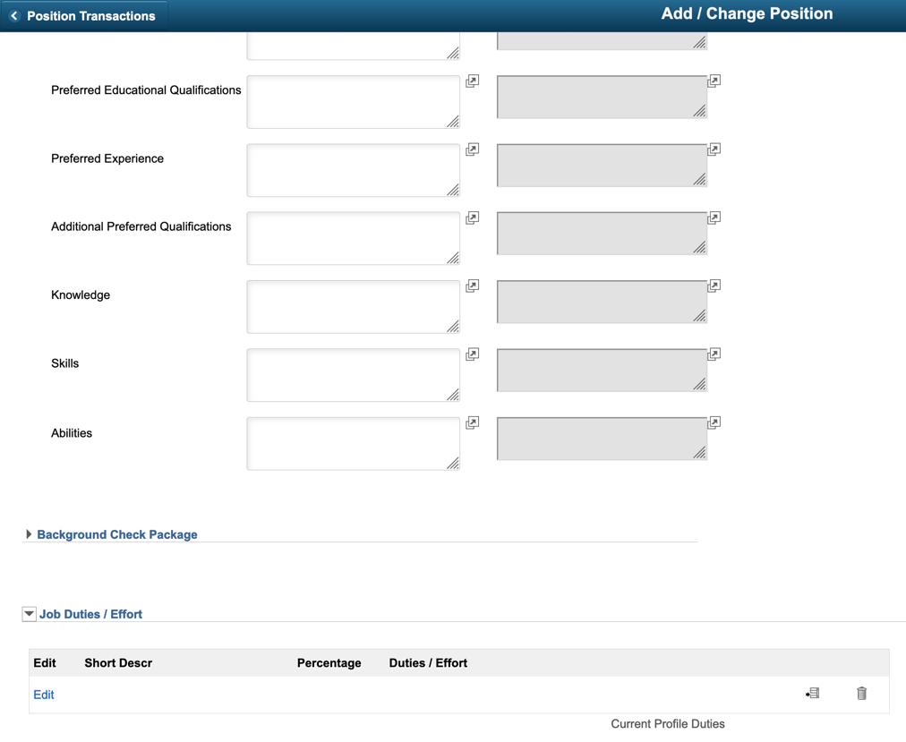
Self Service – Position Management

Slide 30
Quiz
Position Management is comprised of….
  Job Data
  Personal Data
  Position Data
  All the Above

Slide 31
Quiz
Position Management is comprised of….
  Job Data
  Personal Data
  Position Data
  All the Above

Slide 32
Quiz
Lifeguards at the Campus Recreation Center will all be associated with a single position
  True
  False
  It Depends…..

Slide 33
Quiz
Lifeguards at the Campus Recreation Center will all be associated with a single position
  True
  False
  It Depends…..
For multiple employees to be housed in a single position, they must share all position attributes - including
  Reports To Manager
  Department
  Funding

Slide 34
Quiz
Positions are foundational to OneUSG Connect. They can be used to….
  Manage vacant and filled positions
  Track job details and job requisitions
  Facilitate the maintenance of funding and budgets
  All the above

Slide 35
Quiz
Positions are foundational to OneUSG Connect. They can be used to….
  Manage vacant and filled positions
  Track job details and job requisitions
  Facilitate the maintenance of funding and budgets
  All the above

Slide 36

Questions?
Notes:
Katie, Kim, Greg

Slide 37
Competitive Hires
Post Job
Interview and Select Applicant
Extend and Accept Offer
Competitive
Hiring Department GTHR Talent Aquisition
Background Check
Onboarding Packet
Create Employee and Job
(Workforce Administration) (Update HR)
Add/Change Position
Competitive Hire or
Direct Hire
Hiring Department
Georgia Tech Human Resources
Direct
Complete Form
Approval Workflow

Slide 38
Recruiting and Hiring in Careers
Careers will be used to recruit for competitive positions:
  Staff
  Tech Temps
  Full-time Faculty
  Administrative Faculty Appointments
  Faculty Named Positions
  Undergraduate Students
  Graduate Assistants
  Federal Work-Study
Candidates selected via Careers will flow into Manage Hires, and then into Workforce Administration
Notes:
Highlight the bullet and explain details about each.

Slide 39
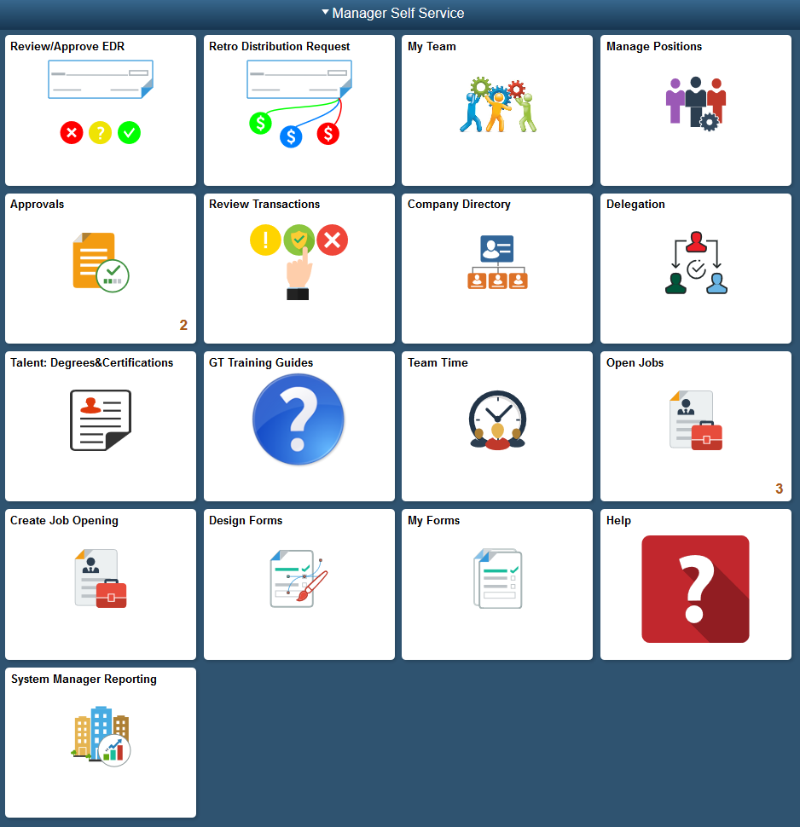
Creating a Job Opening

Slide 40
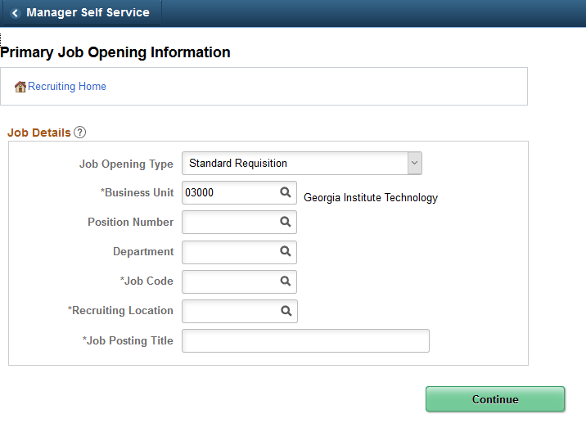
Creating a Job Opening

Slide 41
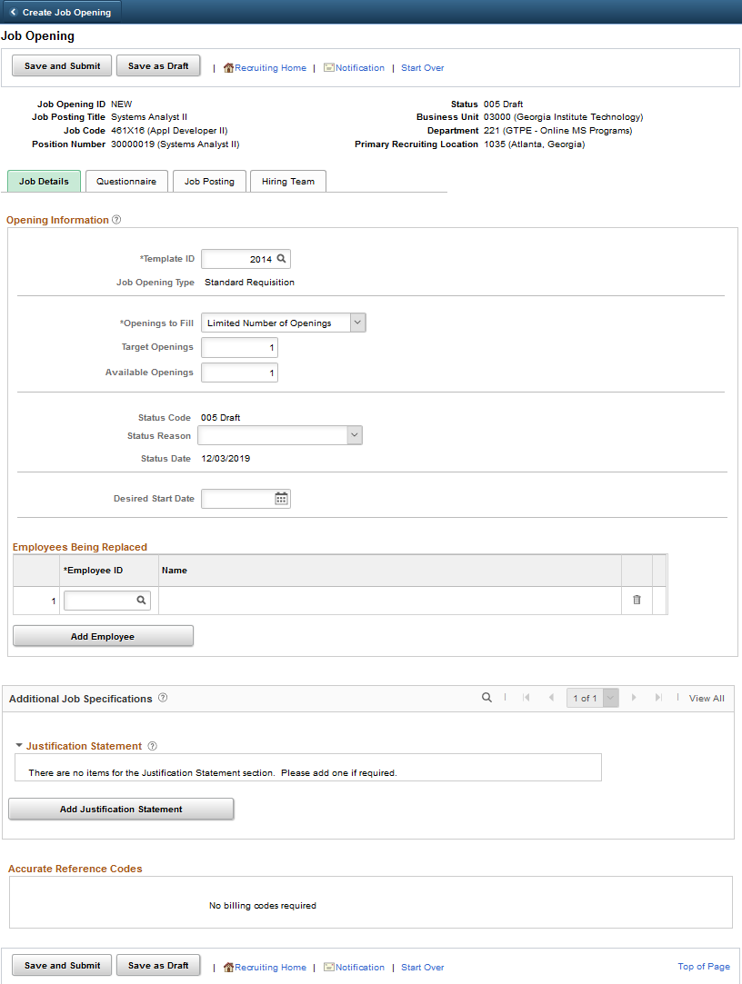
Creating a Job Opening

Slide 42
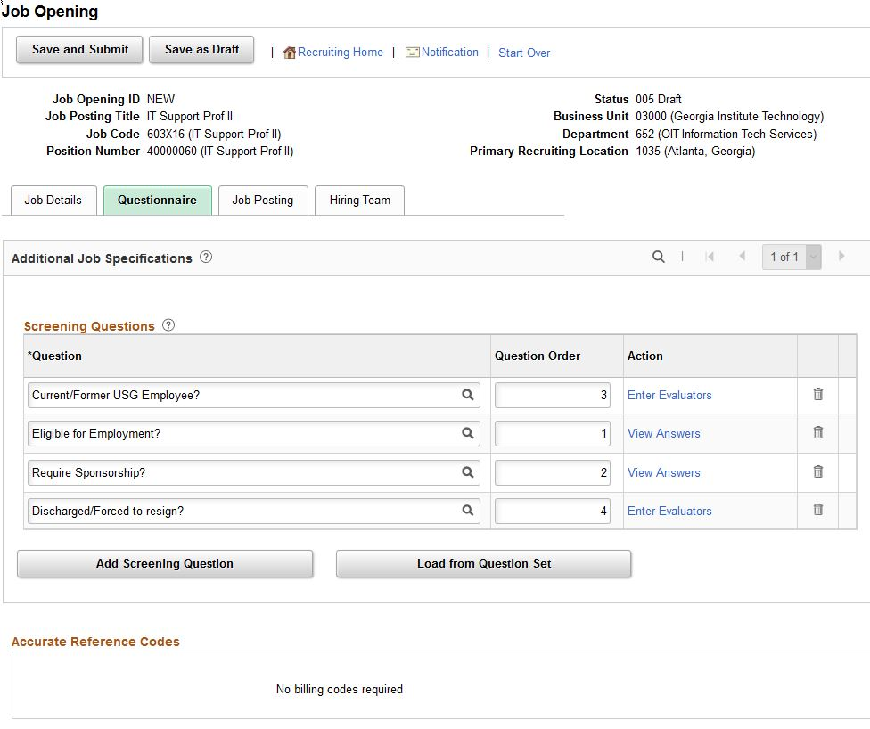
Questionnaire

Slide 43
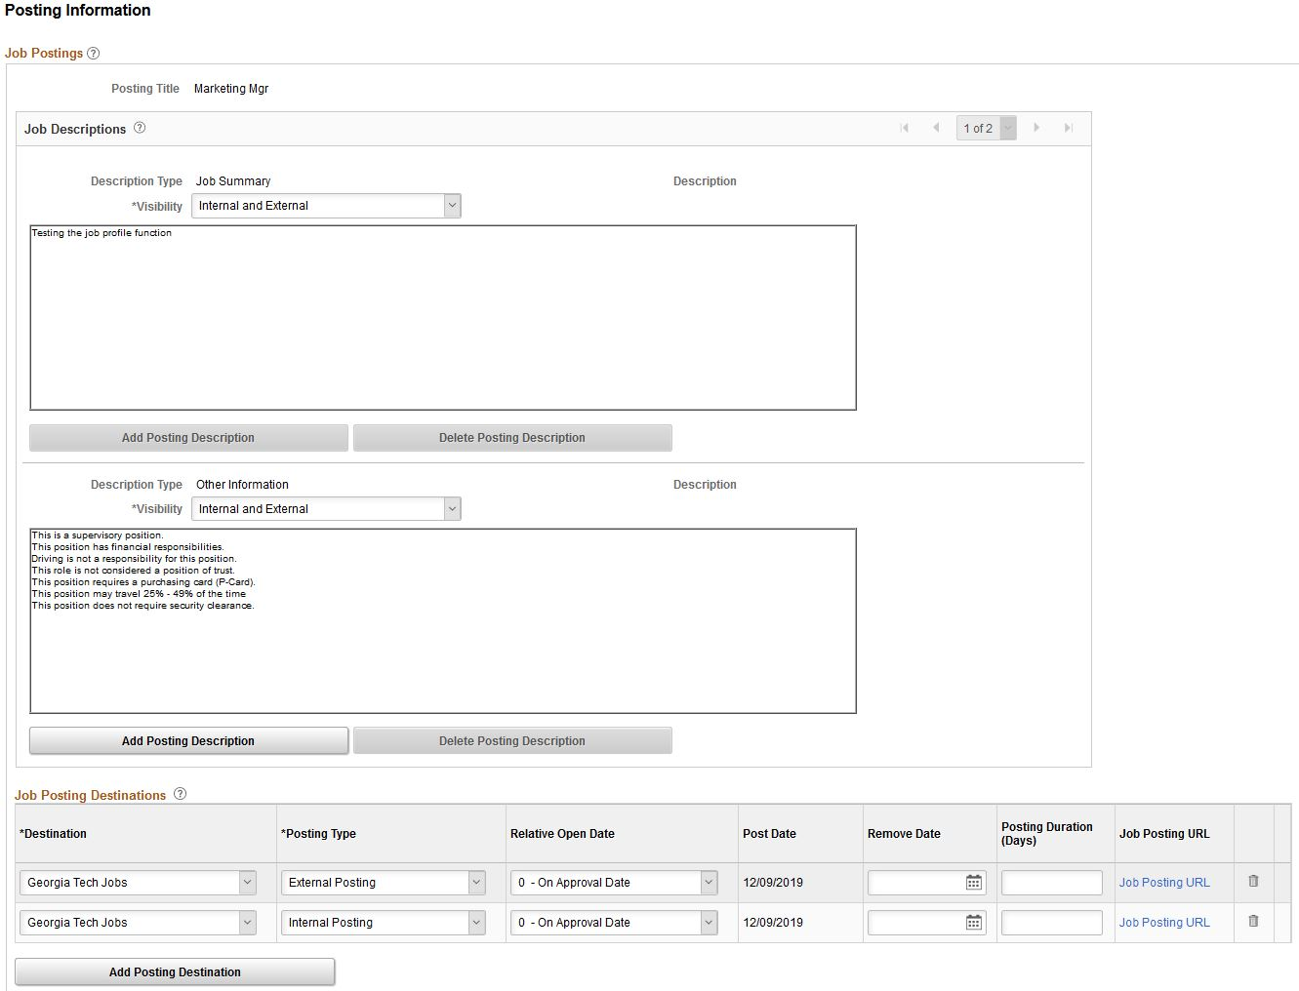
Job Posting

Slide 44
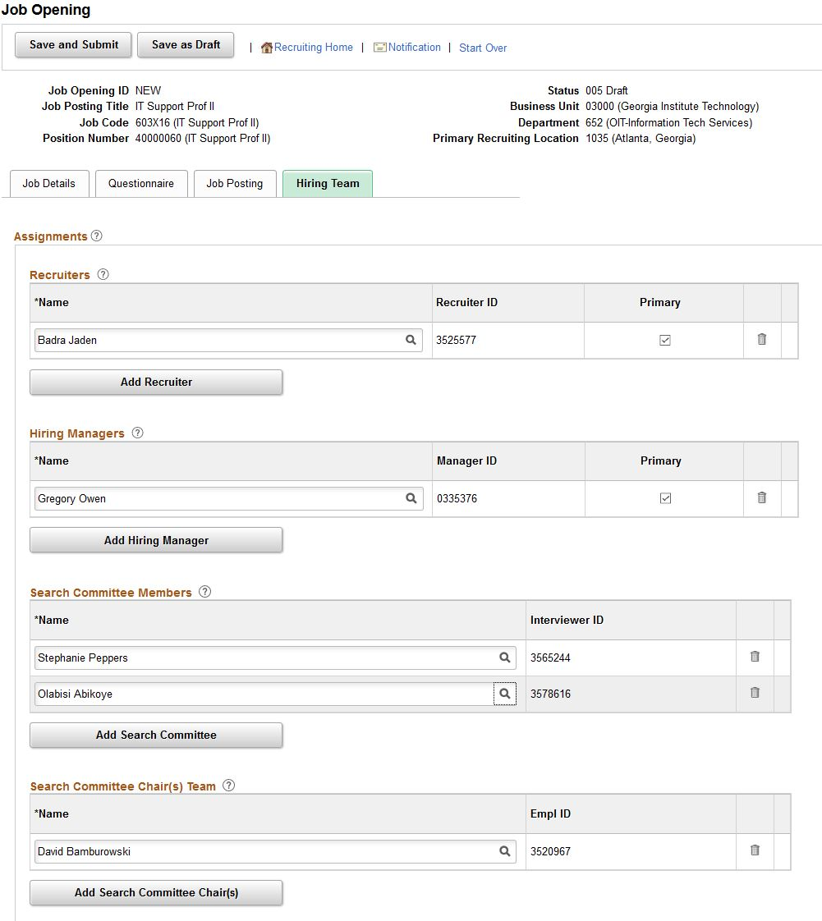
Hiring Team

Slide 45
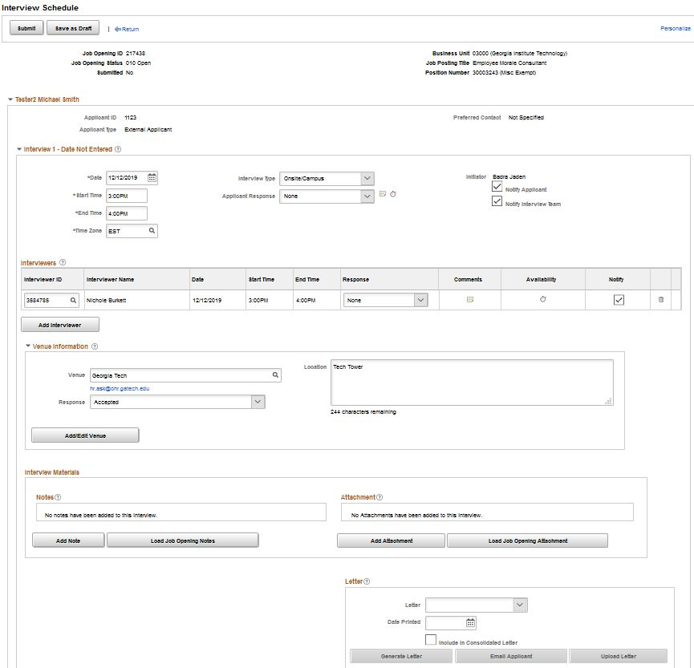
Interview Schedule

Slide 46
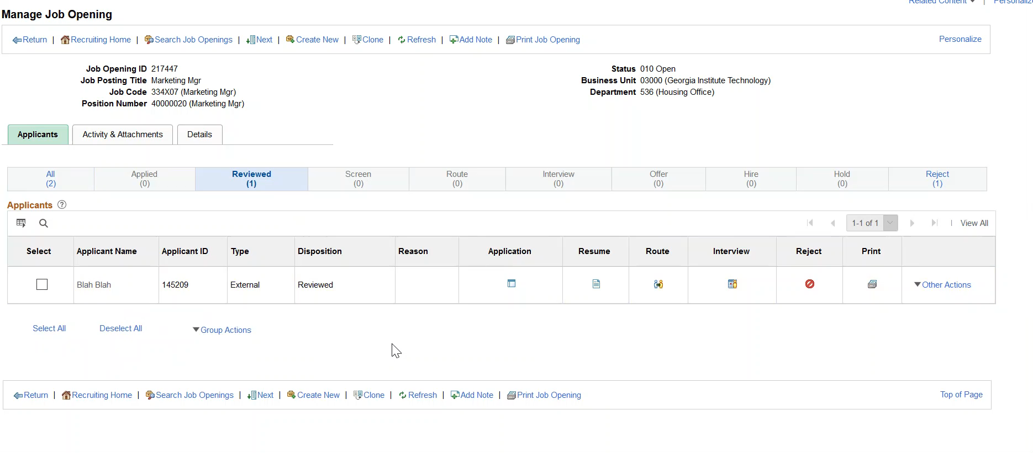
Interview Functionality Demo

Slide 47
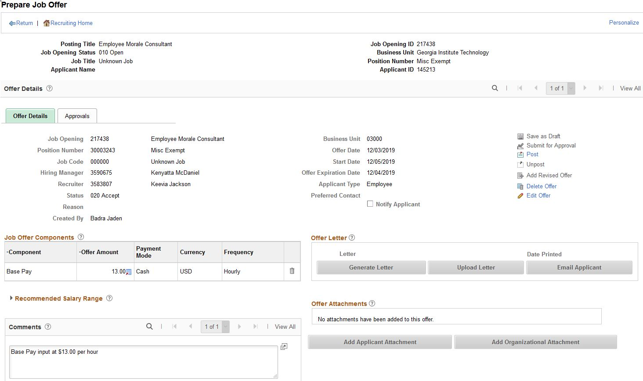
Job Offer

Slide 48
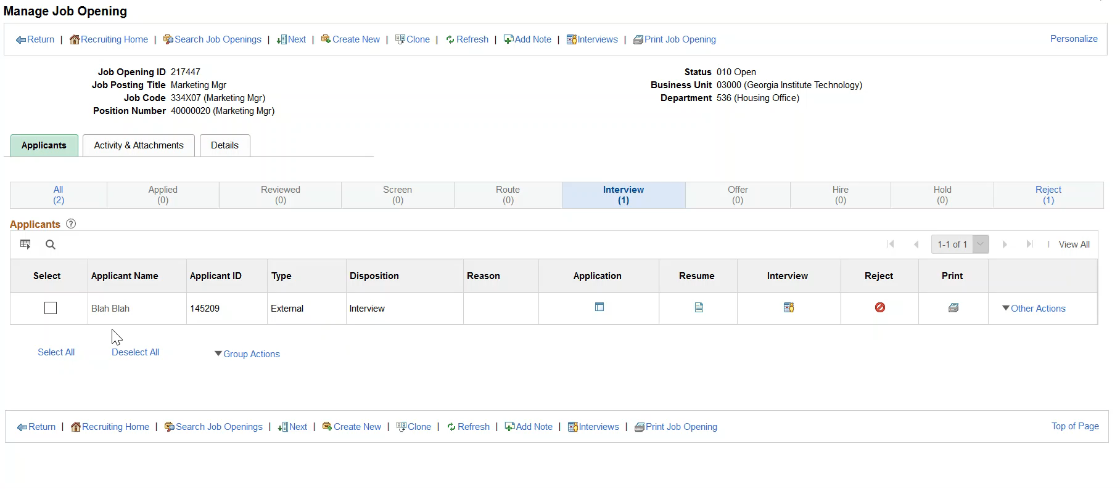
Job Offer Demo

Slide 49
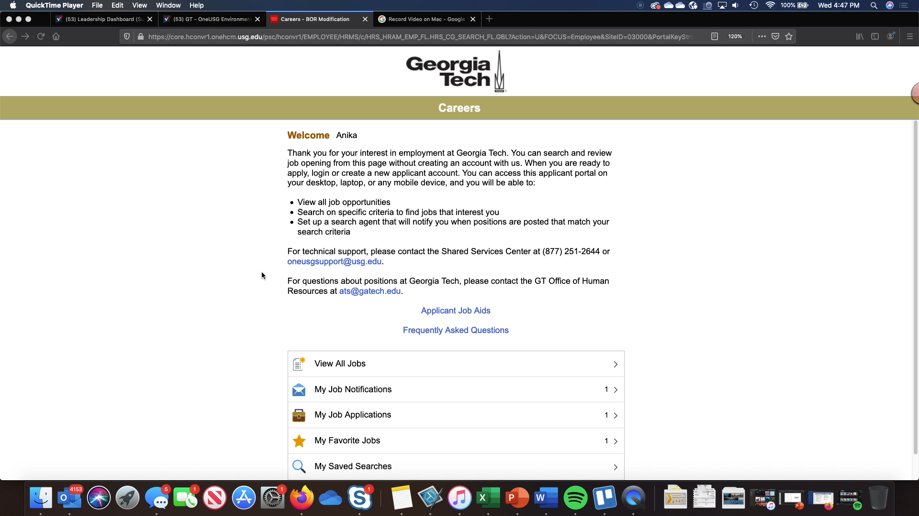
Applicant Experience Demo

Slide 50
Questions?
Notes:
Katie, Kim, Greg

Slide 51
Direct Hires
Post Job
Interview and Select Applicant
Extend and Accept Offer
Competitive
Background Check
Onboarding Packet
Create Employee and Job
(Workforce Administration) (Update HR)
Add/Change Position
Competitive Hire or
Direct Hire
Hiring Department
Georgia Tech Human Resources
Direct
Complete Form
Approval Workflow
Hiring Department GTHR

Slide 52
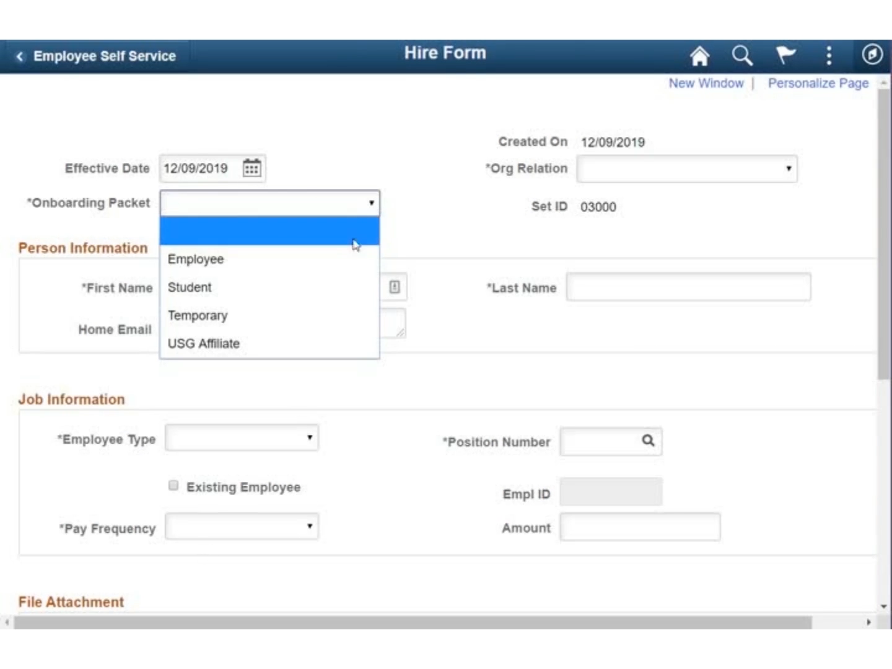
Direct Hire Demo

Slide 53
Questions?
Notes:
Katie, Kim, Greg

Slide 54
Recruitment & Hiring Lifecycle
Post Job
Interview and Select Applicant
Extend and Accept Offer
Competitive
Background Check
Onboarding Packet
Create Employee and Job
(Workforce Administration) (Update HR)
Add/Change Position
Competitive Hire or
Direct Hire
TA CSC HRIP
Georgia Tech Human Resources
Direct
Complete Form
Approval Workflow

Slide 55
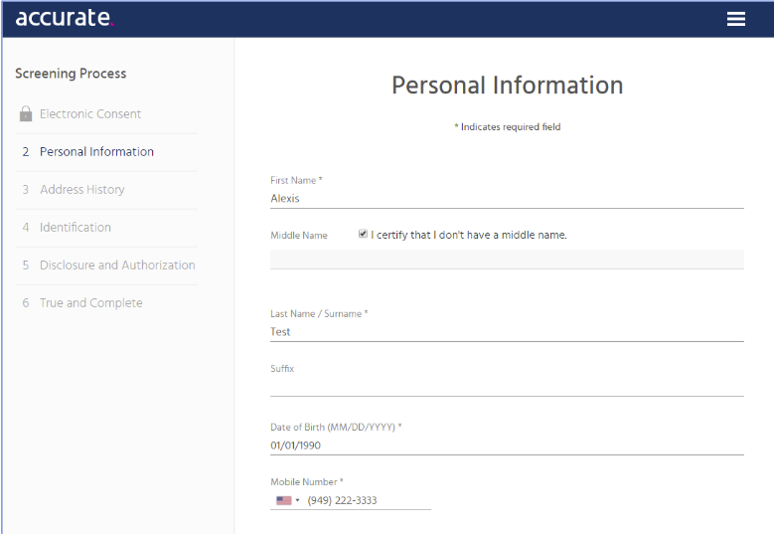
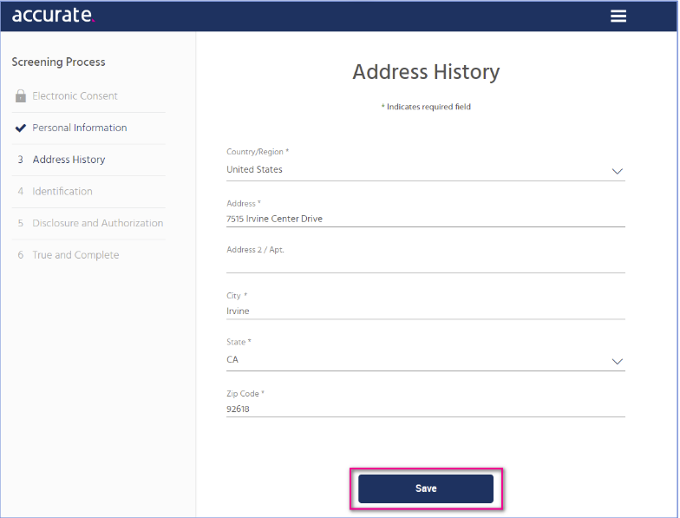
Background Check

Slide 56
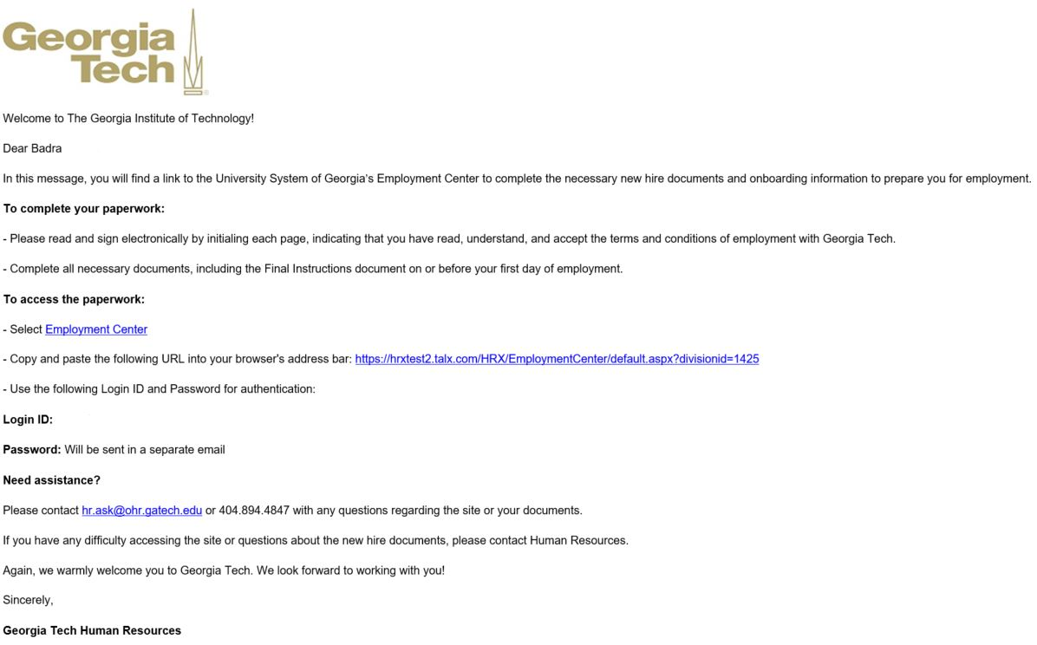
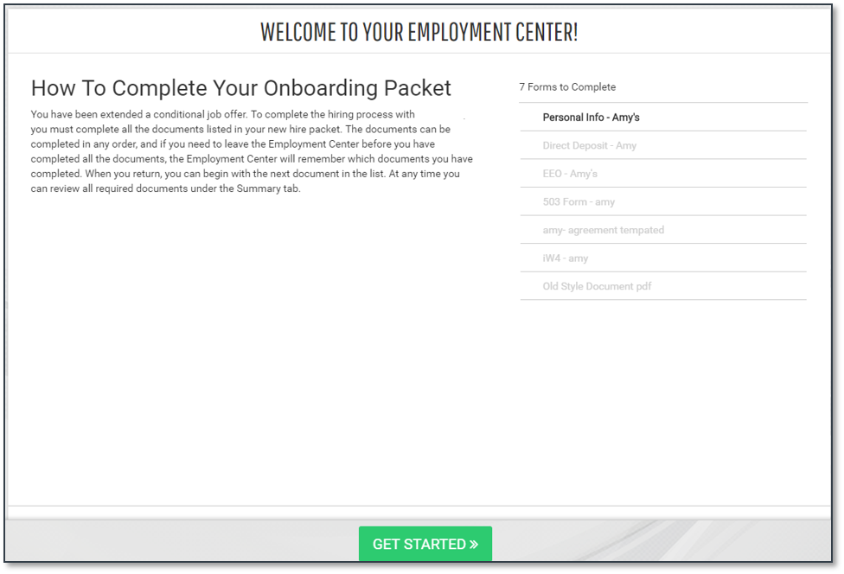
Electronic Onboarding

Slide 57
Questions?
Notes:
Katie, Kim, Greg

Slide 58
What’s Changing with OneUSG Connect?

Slide 59
Careers Security Roles
Role | Current State | Future State
Employee | Access to Internal Georgia Tech postings | Access to Internal Georgia Tech postings
Manager | Ability to create Taleo requisitions | Access to Manager Self-Service
Distributed HR | Roles are assigned based on department request and subsequent training. | Granted by GTHR after completing training. Access to Manager Self-Service and Recruiting functions.
Central HR | Roles are assigned based on job function. | GTHR employees with specific Careers duties (e.g., TA Consultant). Access to Manager Self-Service and expanded Recruiting functions.
Key Takeaway: You will have to complete training to gain access to your applicable role.

Slide 60
Central HR Roles and Responsibilities
What | Who
Job Profiles (job descriptions) | GTHR Compensation
Careers (applicant tracking system) | GTHR Talent Acquisition
Background Checks | GTHR Talent Acquisition
New Hire Onboarding | GTHR Customer Service Center
Manage Hires (PeopleSoft entry) | GTHR HR Information Processing

Slide 61
Significant Changes at Georgia Tech
Full Position Management
Self-Service
  Elimination of PSF
  Add/Change Position
Students and Faculty in one applicant tracking sys​tem
Business Processes – Standardized across USG where appropriate
System-wide Metrics and Reporting
Data Integrity and Compliance – Policies and controls
  Inability to override standardized data at the local level
Support – Tier 1 support by USG Shared Services Center (SSC)

Slide 62
Quiz
Georgia Tech managers and initiators will continue to leverage the PSF form to manage positions
  True
  False

Slide 63
Quiz
Georgia Tech managers and initiators will continue to leverage the PSF form to manage positions
  True
  False

Slide 64
Quiz
Match the Employee Type to the Hire Process (on March 23):
  OneUSG Competitive Hire
  OneUSG Direct Hire Form
  Page Up
  Recruiter Box or Other Resources
  GradWorks
  Staff (including GTRI)
  Tech Temps
  Full-time Faculty
  Administrative Faculty Appointments
  Faculty Named Positions
  Undergraduate Students
  Graduate Assistants
  Research Faculty (Non GTRI)
  Research Faculty (GTRI)

Slide 65
Questions?
Notes:
Katie, Kim, Greg

Slide 66
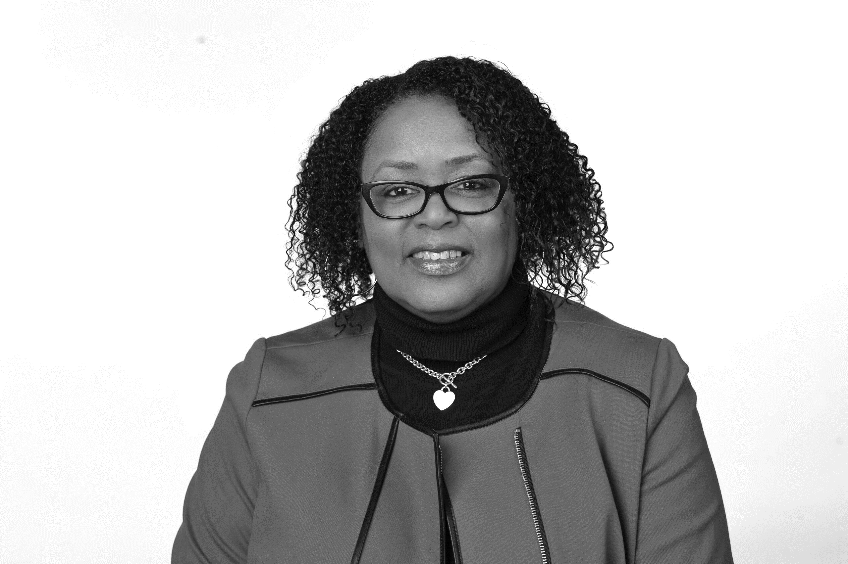
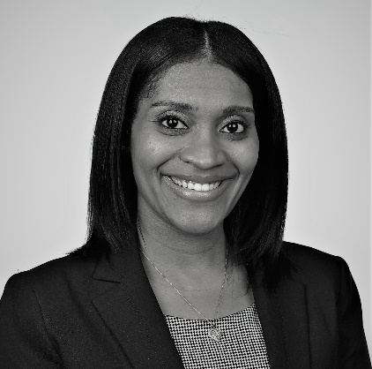
Q&A Panel
Kara Tillman
Organizational Readiness Lead
Charvette Webb
Director-Talent Acquisition & Employee Services/Process Owner
Badra Jaden
Careers Lead
Keisha Williams
Talent Acquisition Manager/Careers Analyst
Notes:
Update as needed

Slide 67
CLOSING

Slide 68
Today’s Objectives
About Info Sessions
OneUSG Connect Program Overview
Recruiting & Hiring Lifecycle Overview
Position Management
Competitive Hires
  Demos
Direct Hires
  Demo
What’s Changing with OneUSG Connect?
Q&A
Closing

